Slide 1
Best of ASCO 2025 Lung Cancer
Gregory J. Riely
Memorial Sloan Kettering Cancer Center
*

Slide 2
Disclosures
MSK has received support for research conducted by me from:
Pfizer
Mirati/BMS
Eli Lilly
Amgen

Slide 3
NSCLC
Long-term results of chemo+IO as neoadjuvant therapy
Targeted therapy in the pre-operative setting
New targeted therapy for EGFR exon 20 insertion NSCLC
Small Cell
Randomized data to support use of tarlatamab
Randomized data to support maintenance lurbinectedin

Slide 4
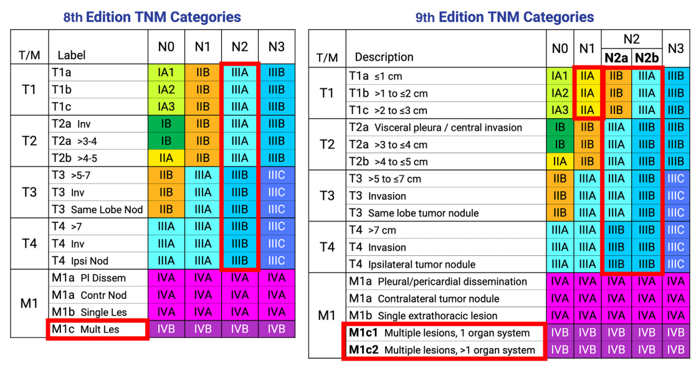
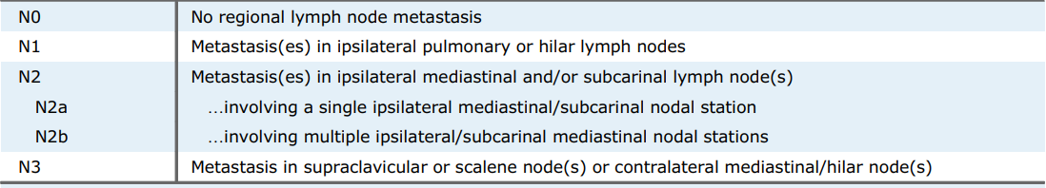
A reminder about AJCC 9th edition staging
Detterbeck, et al Chest 2024

Slide 5
Neoadjuvant therapy endpoints in NSCLC
Pathologic Complete Response pCR
0% viable tumor cells
Major Pathologic Response (MPR)
≤ 10% viable tumor cells

Slide 6
How do we treat early-stage NSCLC?
2 months
3 months
12 months
surgery
chemotherapy
immunotherapy
3 months
chemotherapy
surgery
immunotherapy

Slide 7
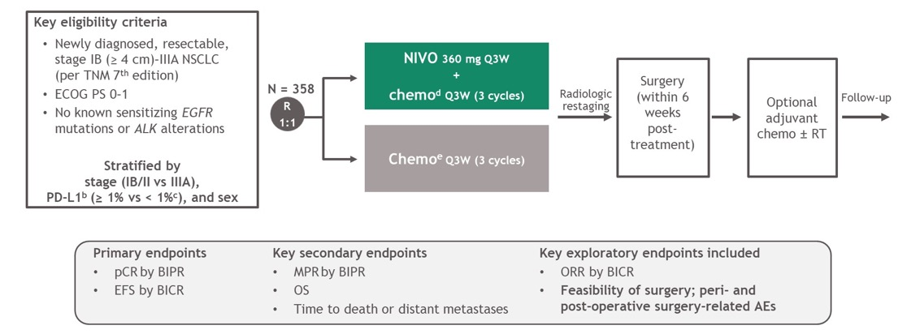
Neoadjuvant nivolumab + chemotherapy
Forde PM et al. N Engl J Med2022;386:1973-1985

Slide 8
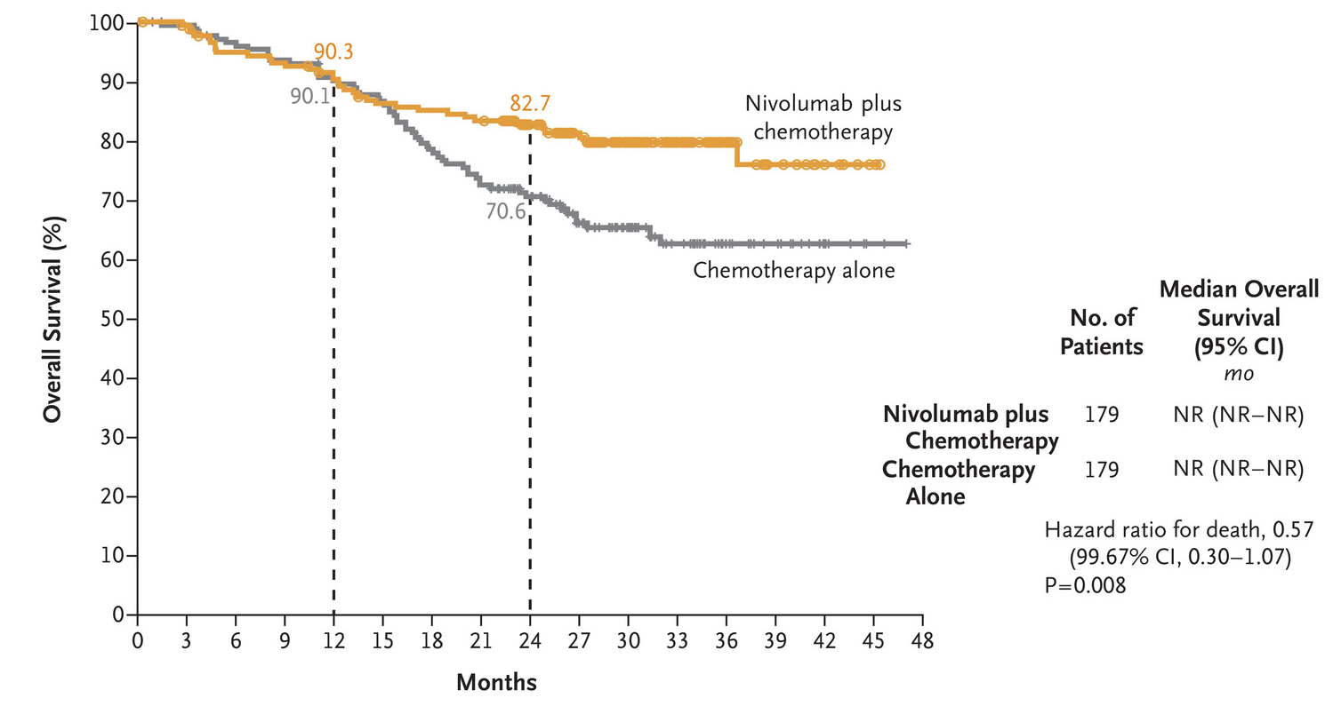
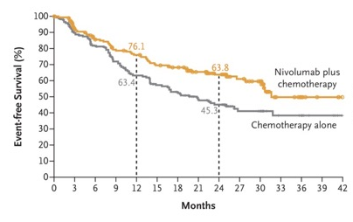
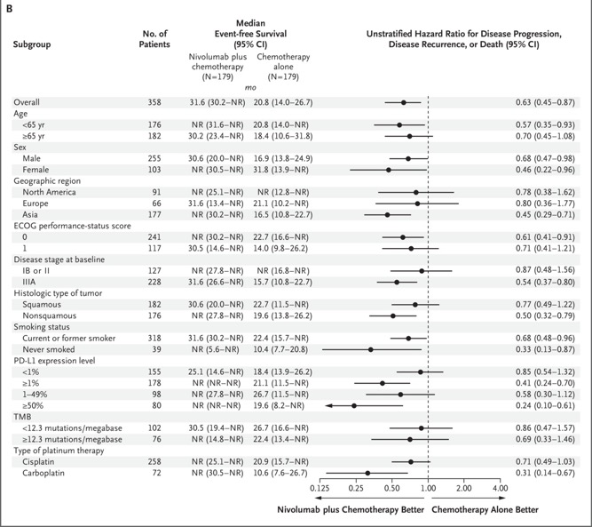
Neoadjuvant nivolumab + chemotherapy
Superior OS when treated with chemotherapy + nivolumab
Forde PM et al. N Engl J Med2022;386:1973-1985

Slide 9
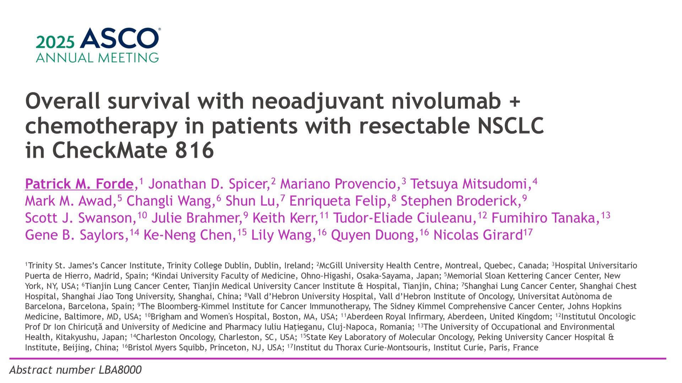
Overall survival with neoadjuvant nivolumab + chemotherapy in patients with resectable NSCLC in CheckMate 816

Slide 10
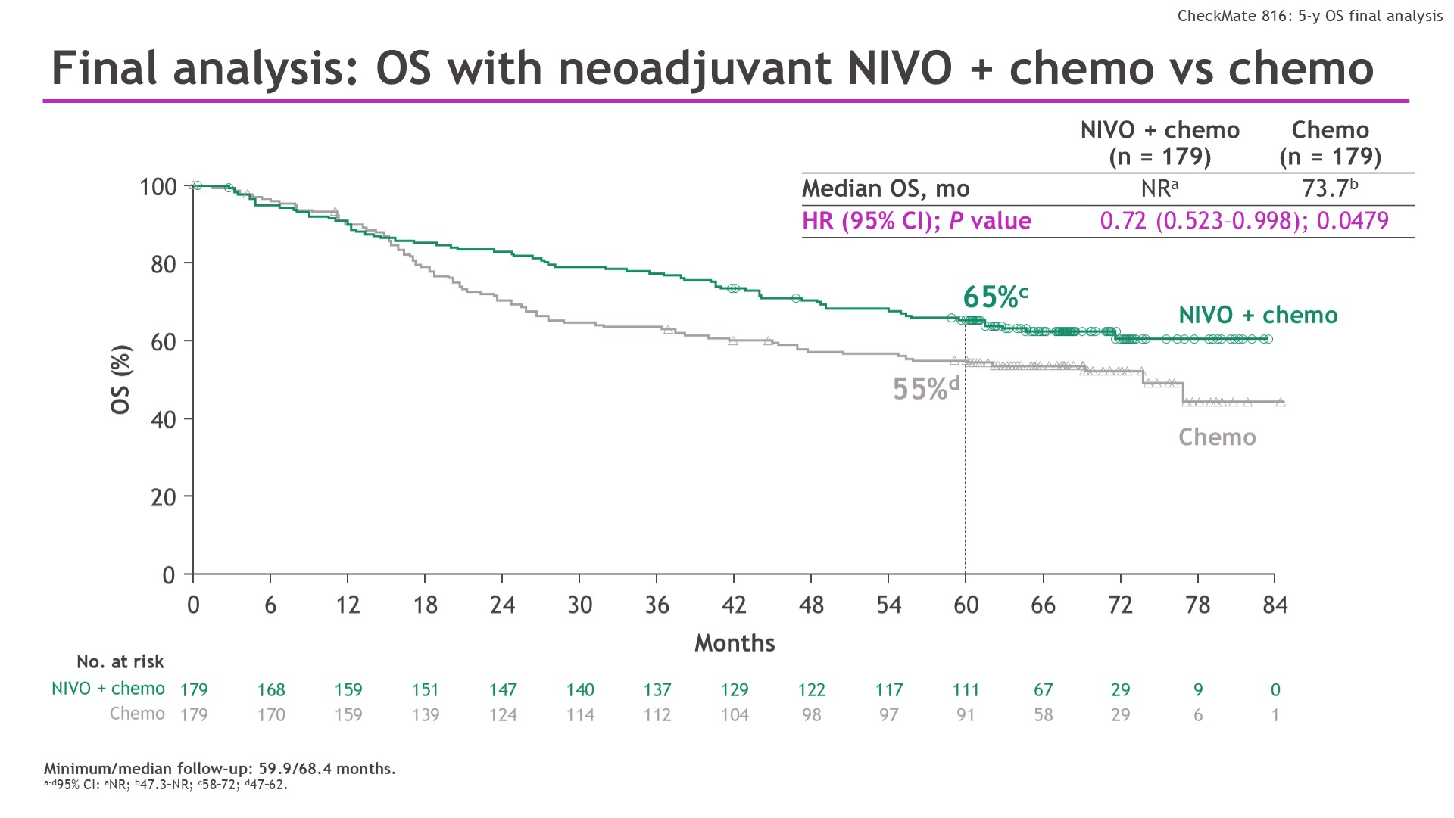
Final analysis: OS with neoadjuvant NIVO + chemo vs chemo
Chemo + Nivo as pre-operative therapy
Forde et al ASCO 2025

Slide 11
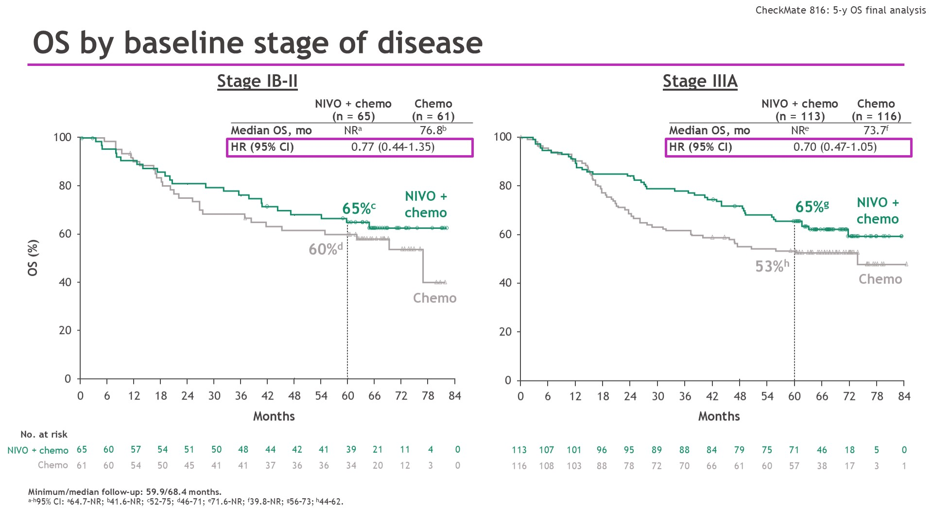
Chemo + Nivo as pre-operative therapy
Forde et al ASCO 2025

Slide 12
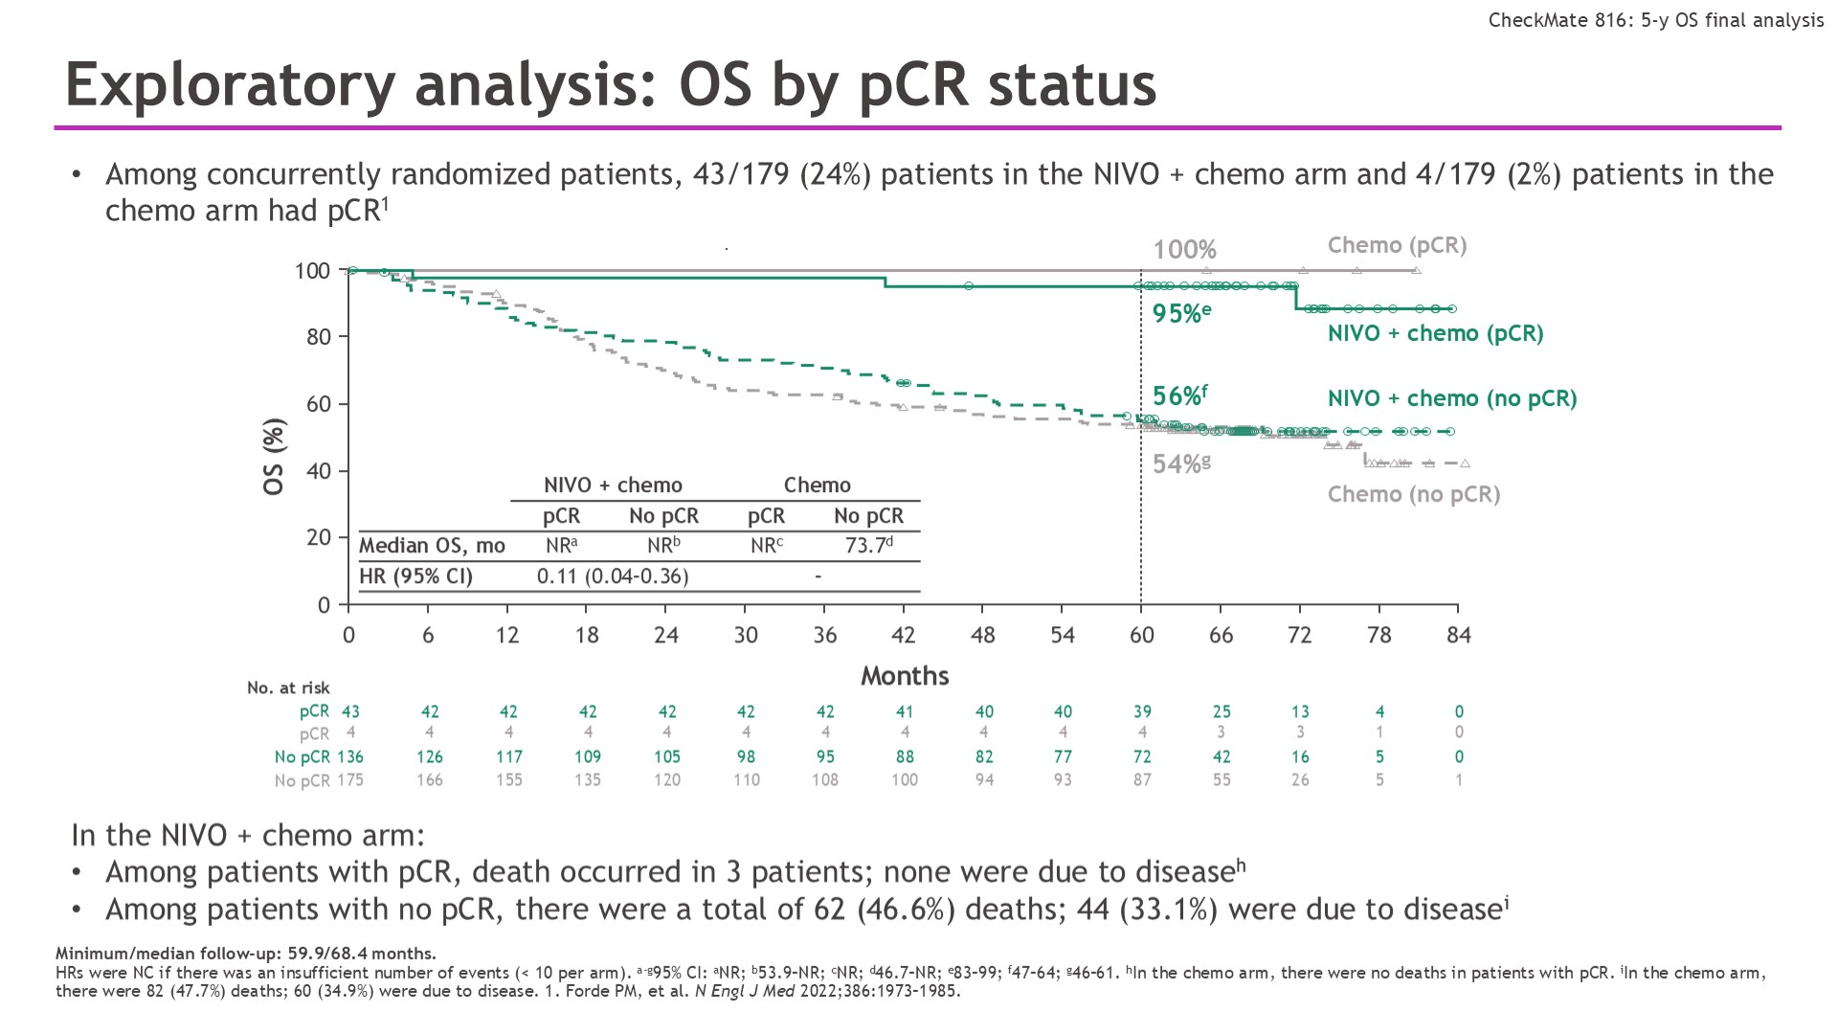
Exploratory analysis: OS by pCR status
Chemo + Nivo as pre-operative therapy
Forde et al ASCO 2025

Slide 13
Summary
Chemo + Nivo as pre-operative therapy
In 5 year analysis of neoadjuvant chemo+nivo, the authors demonstrated a prolonged OS compared with chemotherapy alone
Patients with pathologic complete response (pCR), from whichever treatment, had significant improvement in OS.
pCR rate was much higher in patients who got chemo-nivo
(24% vs 2%)
 | 5-year overall survival
Chemotherapy | 55%
Chemotherapy + nivolumab | 65%

Slide 14
But, what is the context in 2025?

Slide 15
2 months
3 months
12 months
surgery
chemotherapy
immunotherapy
chemotherapy
surgery
immunotherapy

Slide 16
Why not combine both approaches?
chemotherapy
surgery
immunotherapy
immunotherapy

Slide 17

How do we treat early-stage NSCLC? Perioperative therapy summary
 | EFS benefit | OS benefit
Chemo+nivo →surgery
Chemo+pembrolizumab → surgery→ pembrolizumab
Chemo+nivolumab → surgery→ nivolumab
Chemo+durvalumab→ surgery → durvalumab
Do you need the adjuvant?
Periop
regimens
Forde et al, NEJM 2025; Wakelee et al, NEJM 2023; Heymach et al, NEJM 2023; Spicer et al, The Lancet 2024

Slide 18
For some patients with NSCLC, we know immunotherapy plays little role…

Slide 19
For some patients with NSCLC, we know immunotherapy plays little role…
EGFR
ALK

Slide 20
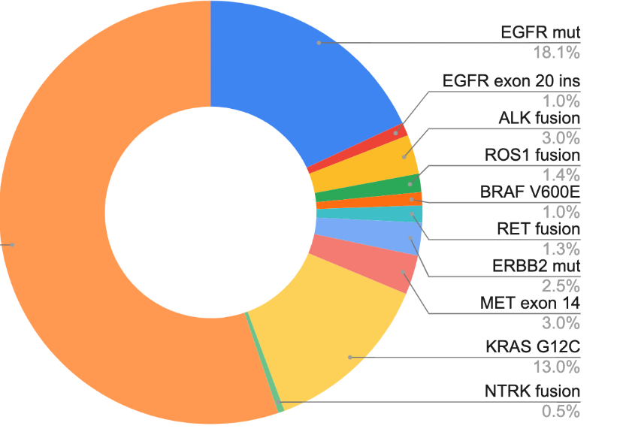
How do we describe NSCLC in 2025?
AACR GENIE BPC lung, Data available at https://genie.cbioportal.org/

Slide 21
How do we treat early-stage NSCLC?
chemotherapy
X
X
surgery
immunotherapy
immunotherapy

Slide 22
How do we treat early-stage NSCLC?
chemotherapy
X
X
surgery
immunotherapy
immunotherapy
surgery
(chemotherapy)
Targeted therapy

Slide 23
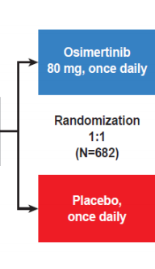
Phase III trial of adjuvant osimertinib
3rd generation EGFR TKI
Patients with:
Completely resected IB-IIIA NSCLC
EGFR exon 19 del or L858R
With or without adjuvant chemotherapy
<10 weeks from surgery (if no chemo)
<26 weeks from surgery (if adjuvant chemo)
x 3 years
Primary endpoint:
disease free survival in stage II-III
76% of stage II-II
26% of stage IB
received chemo
Modified from Wu et al NEJM 2020

Slide 24
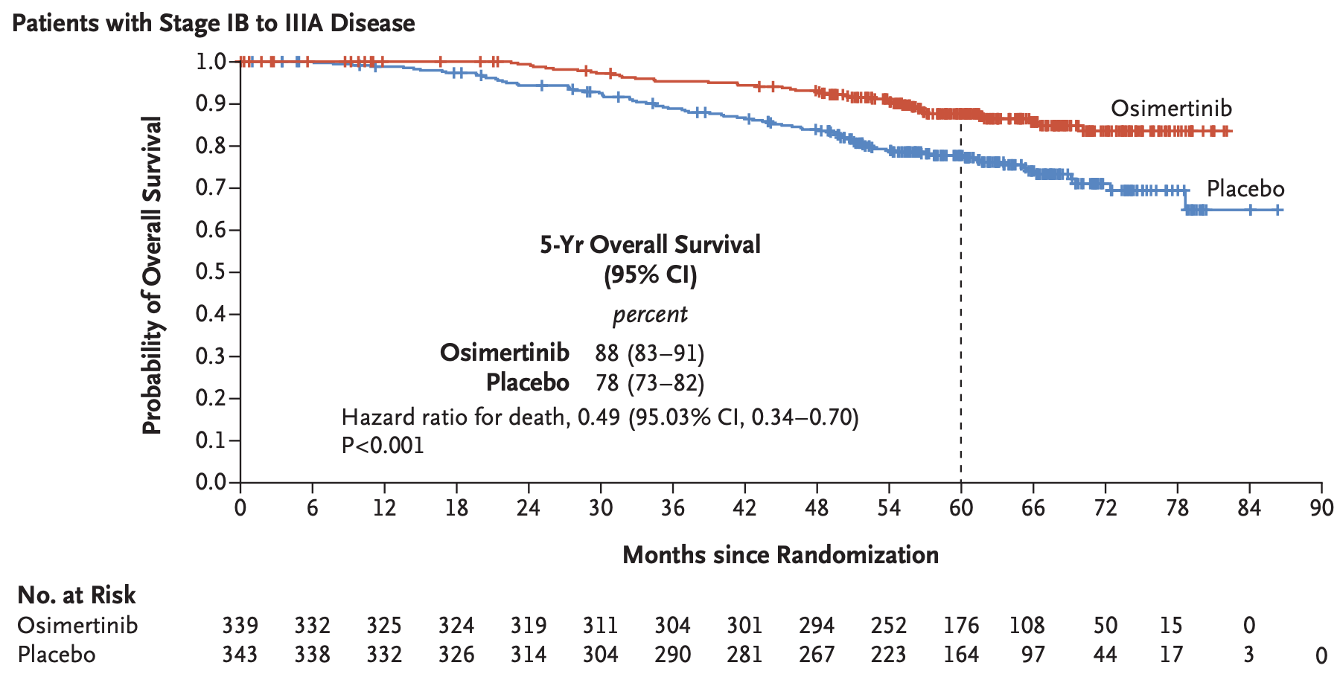
Overall Survival for Adjuvant Osimertinib
Tsuboi et al NEJM 2023

Slide 25
Adjuvant alectinib for patients with ALK+ NSCLC
Resected Stage IB (≥4cm)–IIIA ALK+ NSCLC
per UICC/AJCC 7th edition
Other key eligibility criteria:
ECOG PS 0–1
Eligible to receive platinum-based chemotherapy
Adequate end-organ function
No prior systemic cancer therapy
Stratification factors:
Stage: IB (≥ 4cm) vs II vs IIIA
Race: Asian vs non-Asian
Alectinib 600 mg BID
2 years
R 1:1
Platinum-based chemotherapy†
Q3W; 4 cycles
N=257
Primary endpoint
DFS per investigator,‡ tested hierarchically:
Stage II–IIIA → ITT (Stage IB–IIIA)
Other endpoints
CNS disease-free survival
OS
Safety
Solomon et al, ESMO 2023

Slide 26
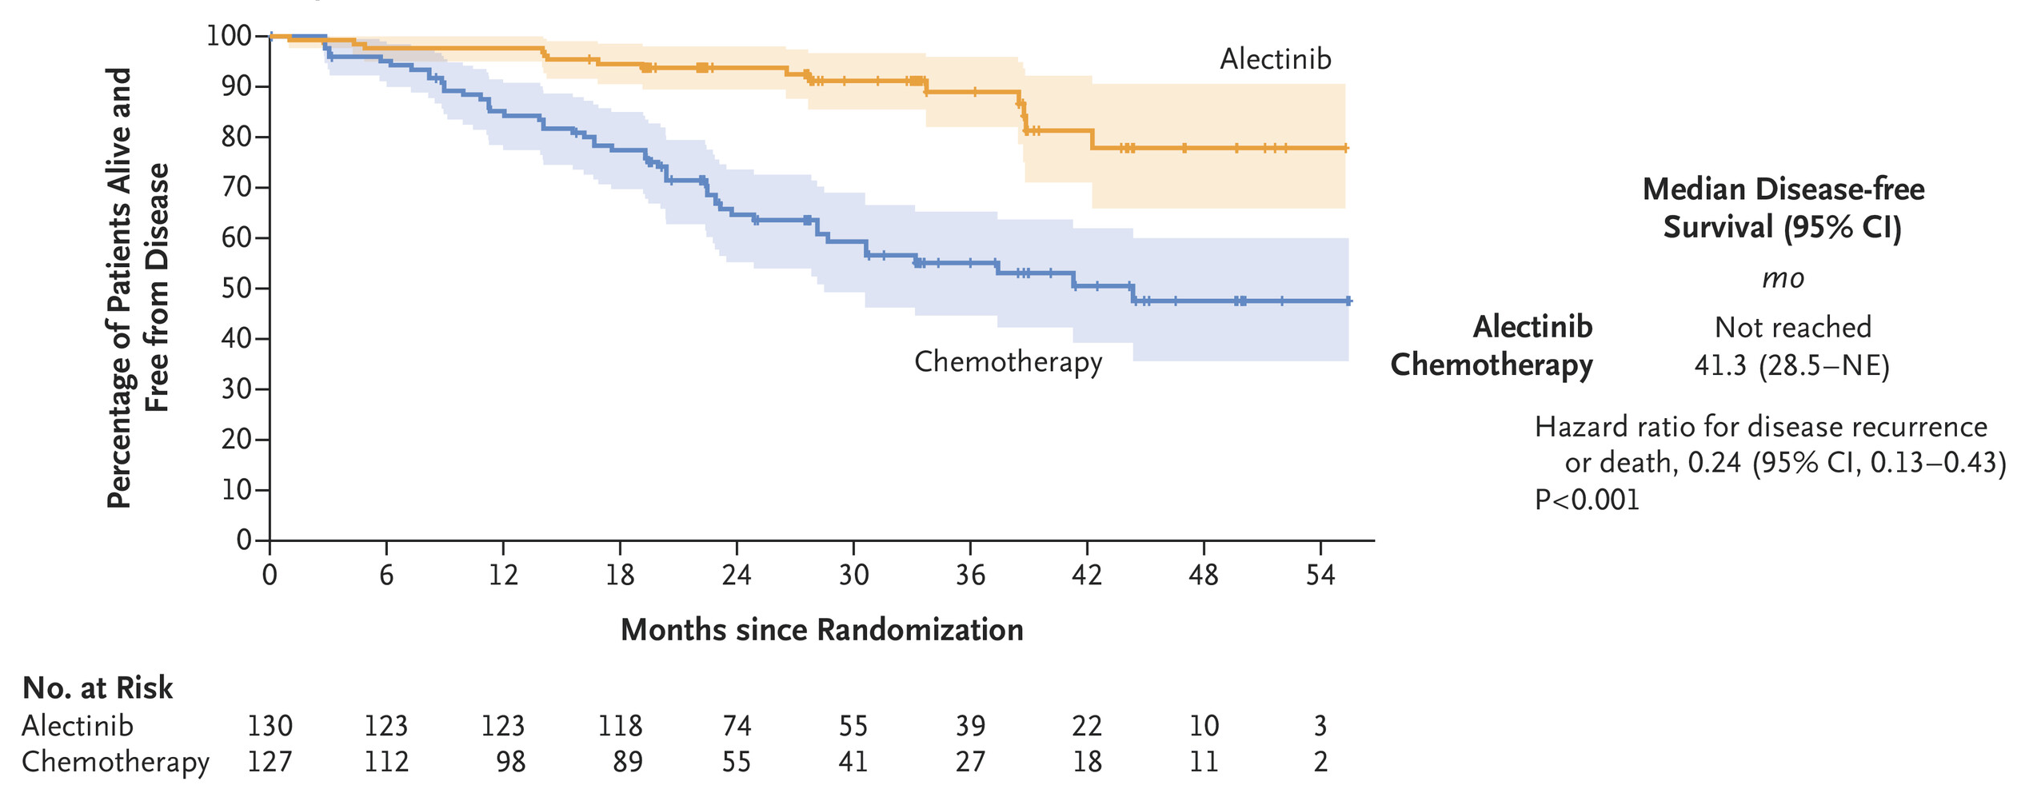
Adjuvant alectinib disease-free survival: ITT (stage IB–IIIA)
Wu et al, NEJM 2024

Slide 27
Why not combine to give before and after?
Targeted therapy
surgery
Targeted therapy
(chemotherapy)

Slide 28
Neoadjuvant osimertinib ± chemotherapy vs chemotherapy alone in resectable epidermal growth factor receptor-mutated (EGFRm) NSCLC: NeoADAURA
Jamie E. Chaft¹, Walter Weder, Jianxing He, Ke-Neng Chen, Maximilian J. Hochmair, Jin-Yuan Shih, Sung Yong Lee, Kang-Yun Lee, Nguyen Viet Nhung, Somcharoen Saeteng, Carlos H.A. Teixeira, Carles Escriu, Alex Martinez-Marti, Collin M. Blakely, Yasushi Yatabe, Sanja Dacic, Xiangning Huang, Yuri Rukazenkov, Anupriya Dayal, Masahiro Tsuboi
¹Thoracic Oncology Service, Memorial Sloan Kettering Cancer Center, New York, NY, USA; Department of Medicine, Weill Cornell Medical College, New York, NY, USA
Dr Jamie E. Chaft

Slide 29
Neoadjuvant osimertinib
Patients with completely resectable EGFRm stage II–IIIB NSCLC*
Osi 80 mg QD (≥9 weeks)§¶ + carboplatin AUC5 or cisplatin 75 mg/m² + pemetrexed 500 mg/m² (Q3W for 3 cycles)
Surgery
N=358
Key inclusion criteria:
Aged ≥18 years
Histologically / cytologically confirmed non-squamous NSCLC
Ex19del / L858R†
WHO PS 0 / 1
Osi mono 80 mg QD (≥9 weeks)¶#
Investigator choice of adjuvant treatment
R 1:1:1
Post-surgery follow-up visits**
Stratification by:
Stage II / III
Chinese‡ / other Asian
/ non-Asian
Ex19del / L858R
PBO QD (≥9 weeks)§¶ + carboplatin AUC5 or cisplatin 75 mg/m² + pemetrexed 500 mg/m² (Q3W for 3 cycles)
Sponsor-supplied adjuvant osi was available for eligible patients who completed surgery in all arms††
Endpoints:
Primary: major pathological response (MPR; by blinded central pathology review)
Secondary: event-free survival, pathological complete response, nodal downstaging and safety
Chaft et al, ASCO 2025
Dr Jamie E. Chaft

Slide 30
Neoadjuvant Osimertinib:
Reasons for not undergoing or completing surgery
Fewer patients had progressive disease precluding definitive surgery with both osi-containing regimens
Reasons for not completing definitive surgery:
Other*
AE
Progressive disease
2%
2%
8%
1%†
3%
6%
5%
Completed definitive surgery: 90%
Completed definitive surgery: 95%
Completed definitive surgery: 88%
Osi + CTx (n=121)
Osi mono (n=117)
PBO + CTx (n=120)
Dr Jamie E. Chaft
Chaft et al, ASCO 2025

Slide 31
Neoadjuvant Osimertinib:
Major pathologic response rate
The MPR rate was statistically significantly higher with both osi-containing regimens
Difference, 24% (95% CI 15, 32);
OR, 19.8 (95.002% CI 4.6, 85.3); p<0.0001
Difference, 23% (95% CI 15, 32); OR, 19.3 (99.9% CI 1.7, 217.4); p<0.0001
MPR rate, %
Osi + CTx (n=121)
Osi mono (n=117)
PBO + CTx (n=120)
Dr Jamie E. Chaft
Chaft et al, ASCO 2025

Slide 32
Neoadjuvant Osimertinib:
Depth of pathological response
Depth of pathological response was greater with the osi-containing regimens
Overall Response:
Non-MPR
MPR
pCR
26%
Osi + CTx (n=121)
4%
0
-20
-40
-60
-80
-100
25%
Osi mono (n=117)
9%
0
Regression in tumor area with viable tumor cells (%)
-20
-40
-60
-80
-100
2%
PBO + CTx (n=120)
0
-20
-40
-60
-80
-100
Patients
Dr Jamie E. Chaft
Chaft et al, ASCO 2025

Slide 33
Neoadjuvant Osimertinib:
Interim EFS analysis (15% maturity)
93%
100
95%
EFS HR vs PBO + CTx
Osi + CTx: 0.50 (99.8% CI 0.17, 1.41); p=0.0382†
Osi mono: 0.73 (95% CI 0.40, 1.35)†
90
80
83%
70
60
50
Event-free survival (%)
40
30
Median follow-up, months‡
osi + CTx 14.3, osi mono 18.3, PBO + CTx 14.3
20
10
Planned surgery
0
0
3
6
9
12
15
18
21
24
27
30
33
36
39
42
No. at Risk
Time since randomization (months)
Osi + CTx
121
112
110
93
89
58
54
39
38
23
22
14
10
6
0
Osi mono
117
112
110
98
94
59
59
36
34
20
18
9
7
6
0
PBO + CTx
120
107
100
85
81
55
52
35
34
20
16
11
6
4
0
Dr Jamie E. Chaft
Chaft et al, ASCO 2025

Slide 34
Neoadjuvant Osimertinib:
Most common AEs* (neoadjuvant period)†
Safety findings were consistent with the known profiles of the individual agents
^{Osi + CTx}
^{PBO + CTx}
^{Osi mono}
^{PBO + CTx}
Nausea
28
1
3
Diarrhea
3
AESI, n (%) | Osi + CTx (n=119) | PBO + CTx (n=120) | Osi mono (n=117)
Wound complications | 2 (2) | 0 | 1 (1)
Cardiac effects | 1 (1) | 2 (2) | 3 (3)
ILD / pneumonitis | 0 | 0 | 2 (2)
Constipation
27
1
Constipation
Neutrophil count decreased
25
11
6
Cough
Diarrhea
24
1
Rash
Rash
24
1
Dermatitis acneiform
Decreased appetite
21
1
Paronychia
Platelet count decreased
19
8
Procedural pain
Anemia
18
1
5
Osi + CTx, any grade
18
Stomatitis
1
Stomatitis
Nausea
3
Osi + CTx, max. grade ≥3
WBC count decreased
13
1
1
PBO + CTx, any grade
Cough
11
Decreased appetite
PBO + CTx, max. grade ≥3
Vomiting
11
1
Anemia
1
5
Osi mono, any grade
Pyrexia
11
Fatigue
1
Osi mono, max. grade ≥3
Fatigue
9
1
Neutrophil count decreased
6
Procedural pain
5
Vomiting
Proportion of patients with AE (%)
Proportion of patients with AE (%)
Dr Jamie E. Chaft
Chaft et al, ASCO 2025

Slide 35
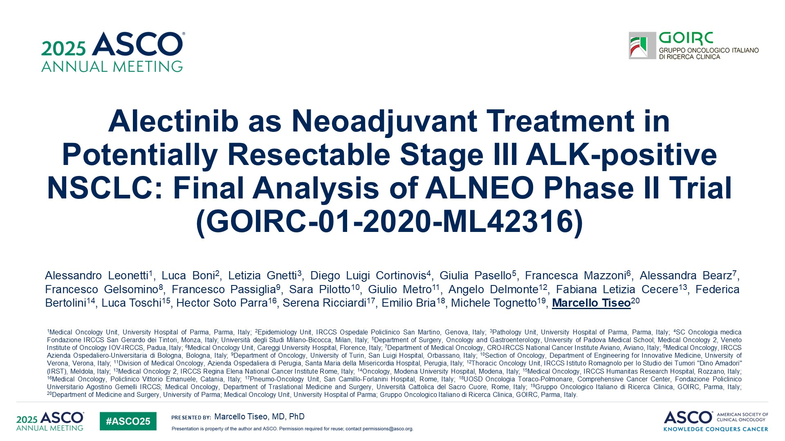
Alectinib as Neoadjuvant Treatment in Potentially Resectable Stage III ALK-positive NSCLC: Final Analysis of ALNEO Phase II Trial (GOIRC-01-2020-ML42316)
Content of this presentation is the property of the author, licensed by ASCO. Permission required for reuse.

Slide 36
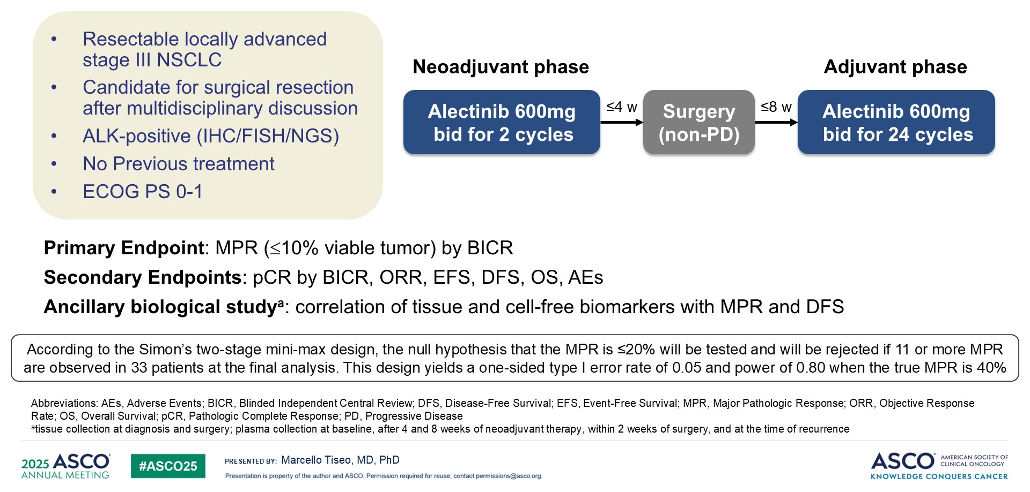
Neoadjuvant alectinib
Leonetti et al, ASCO 2025

Slide 37
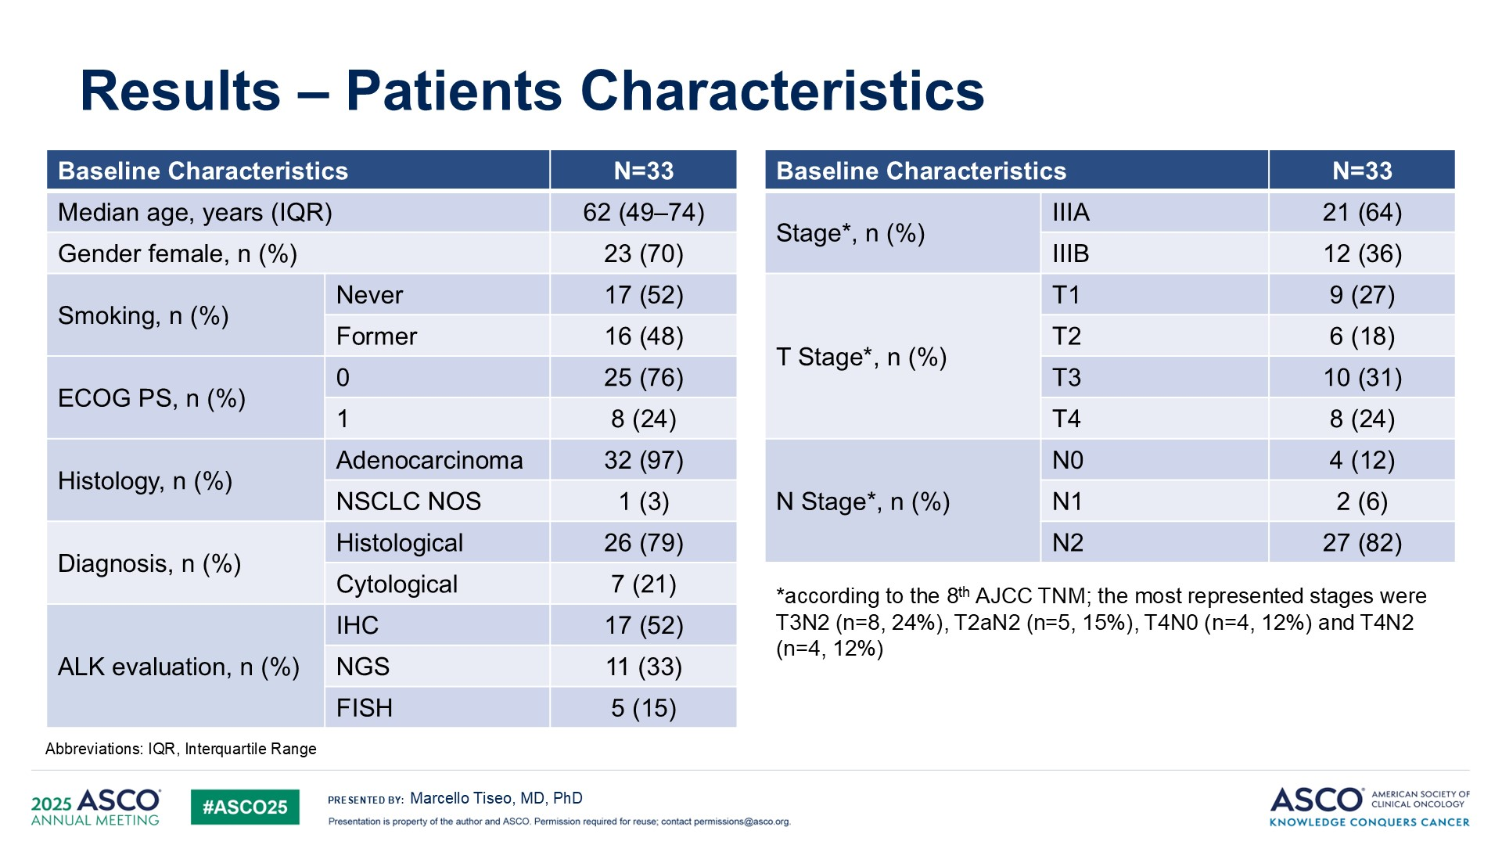
Slide 6
Neoadjuvant alectinib
Leonetti et al, ASCO 2025

Slide 38
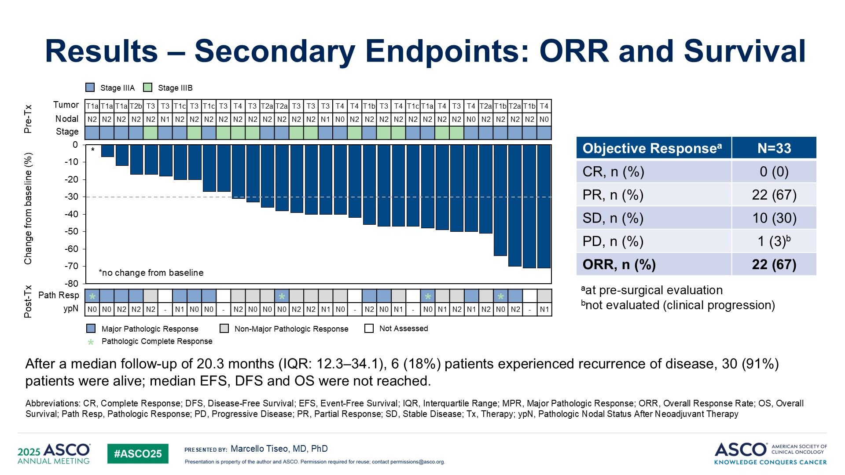
Slide 8
Neoadjuvant alectinib
MPR = 42%
pCR = 12%
Leonetti et al, ASCO 2025

Slide 39
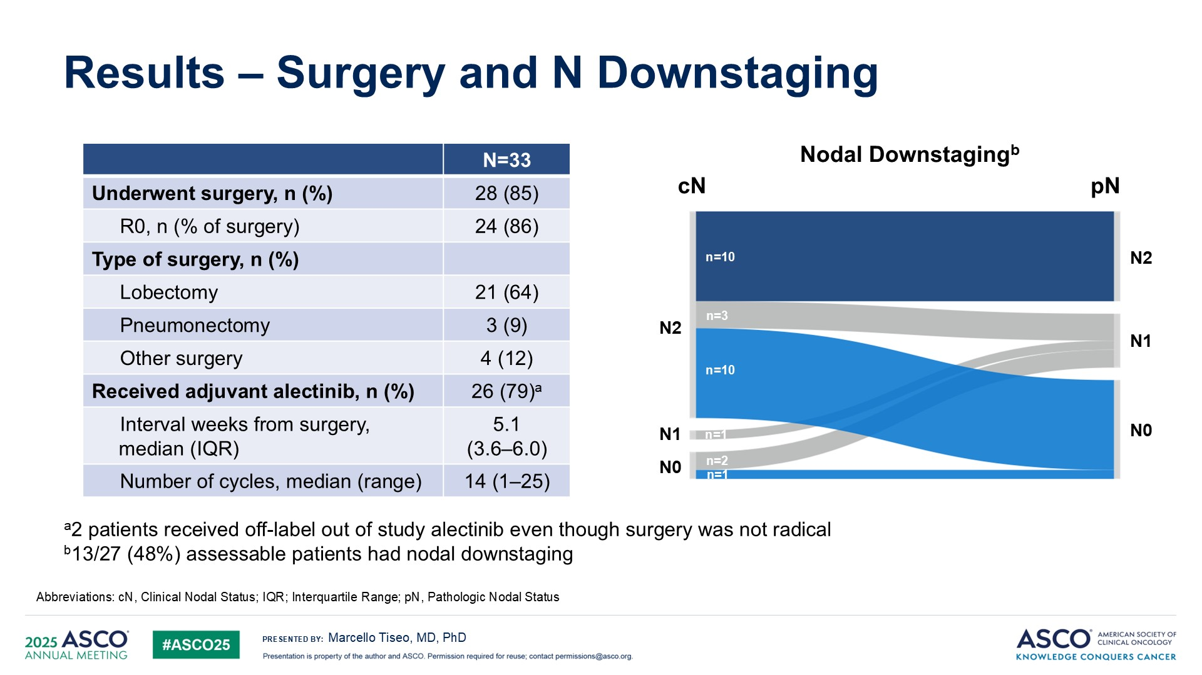
Slide 9
Neoadjuvant alectinib
Leonetti et al, ASCO 2025

Slide 40
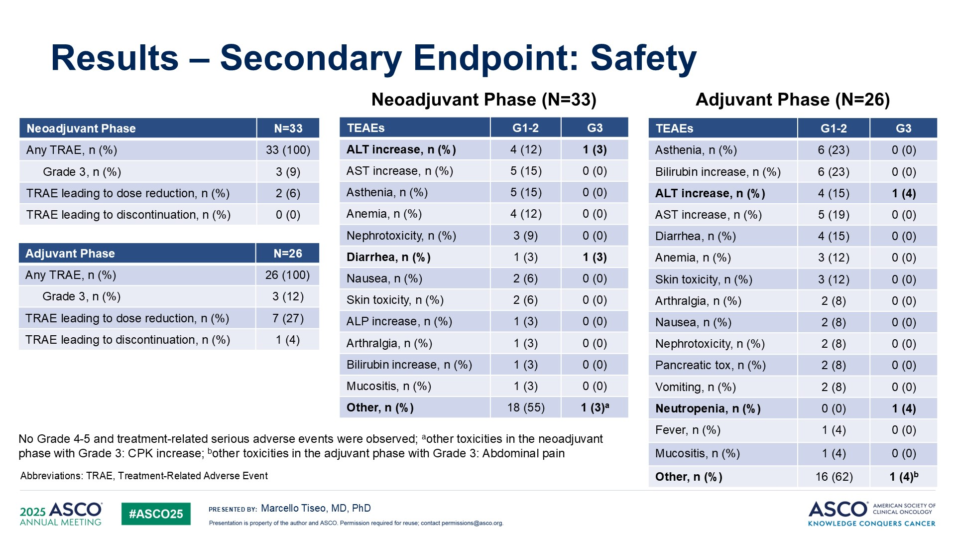
Results – Secondary Endpoint: Safety
Neoadjuvant alectinib
Leonetti et al, ASCO 2025

Slide 41
Early Stage NSCLC Conclusions
The addition of nivolumab to pre-operative chemotherapy shows long term improvement in overall survival
10% improvement at 5 years with the addition of 3 cycles of nivolumab)
For patients with ALK positive or EGFR mutant (exon 19 del/L858R) early stage NSCLC, it’s reasonable to consider the incorporation of targeted therapy into pre-operative treatment based on high path response rates.
Alectinib with major path response in 42% with 8 weeks of therapy
Osimertinib with major path response in 25% with 9 weeks of therapy
Osimertinib + chemotherapy with major path response in 26% with 3 cycles

Slide 42
NSCLC Targets 2025
AACR GENIE BPC lung, Data available at https://genie.cbioportal.org/

Slide 43
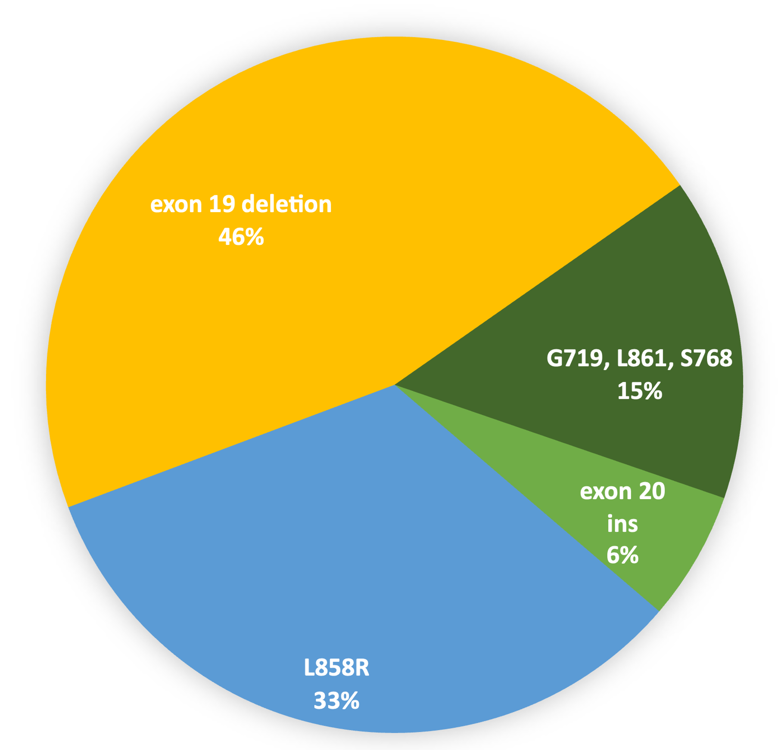
EGFR has become more complicated Among patients with EGFR mutant NSCLC…
79% of patient have classically sensitizing EGFR mutations (exon 19 deletion and L858R)
15% of patient have “atypical” EGFR mutations
6% of patient have EGFR exon 20 insertions
From AACR GENIE v 11 public, Data available at https://genie.cbioportal.org/

Slide 44
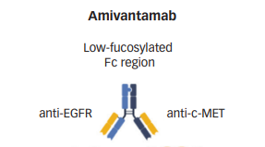
Agents for EGFR exon 20 insertion NSLC
Tyrosine kinase inhibitor
oral
Antibody
IV
Gonzalvez et al, Can Discovery 2021; adapted from Guo et al, Touch Reviews 2021

Slide 45
Amivantamab (EGFR – MET bi-specific Ab) as 2nd-line therapy in Patients with EGFR exon 20 insertion NSCLC
mPFS 8.3 months
mOS 22.8 months
Park et al, JCO 2021

Slide 46
Amivantamab for first-line treatment of patients with EGFR exon 20 ins NSCLC
carboplatin
pemetrexed
Recurrent/Metastatic NSCLC
EGFR Exon 20 insertion
No prior systemic therapy
N=308
Primary endpoint
PFS by BICR using RECIST v1.1
R
carboplatin
pemetrexed
+
amivantamab
Zhou et al, NEJM 2023

Slide 47
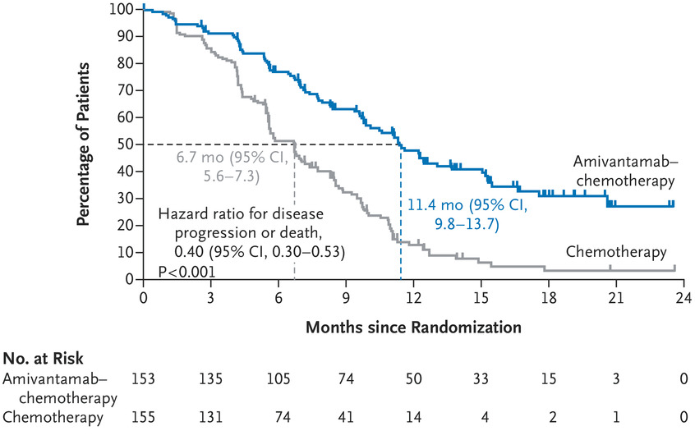
Amivantamab for first-line treatment of patients with EGFR exon 20 ins NSCLC
Zhou et al, NEJM 2023

Slide 48
Efficacy of zipalertinib in NSCLC patients with EGFR exon 20 insertion mutations who received prior platinum-based chemotherapy with or without amivantamab
Helena Alexandra Yu,¹ Danny Nguyen,² Gerrina Ruiter,³ Victor Ho-Fun Lee,⁴ Ross A. Soo,⁵ Se Hyun Kim,⁶ Daniel Shao-Weng Tan,⁷ Se-Hoon Lee,⁸ Haruko Daga,⁹ Vamsidhar Velcheti,¹⁰ James Chih-Hsin Yang,¹¹ Antonio Passaro,¹² Gonzalo Fernandez-Hinojal,¹³ Alexander I. Spira,¹⁴ Oscar Juan-Vidal,¹⁵ Sang-We Kim,¹⁶ Shengting Li,¹⁷ Zhiying Cindy Xu,¹⁷ Jeffrey Alan Jones,¹⁷ Zofia Piotrowska¹⁸
¹Memorial Sloan Kettering Cancer Center, New York, NY; ²City of Hope- Long Beach Elm, Long Beach, CA; ³Departments of Clinical Pharmacology and Thoracic Oncology, Netherlands Cancer Institute, Amsterdam, Netherlands; Department of Clinical Oncology, ⁴The University of Hong Kong, Hong Kong, Hong Kong; ⁵National University Hospital Singapore, Singapore, Singapore; ⁶Division of Hematology-Oncology, Department of Internal Medicine, Seoul National University Bundang Hospital, Seongnam, Republic of Korea; ⁷Division of Medical Oncology, National Cancer Centre Singapore, Duke-NUS Medical School, Singapore, Singapore; ⁸Division of Hematology-Oncology, Department of Medicine, Samsung Medical Center, Sungkyunkwan University School of Medicine, Seoul, Republic of Korea; ⁹Osaka City General Hospital, Osaka, Japan; ¹⁰Laura and Isaac Perlmutter Cancer Center, New York, NY; ¹¹Department of Oncology, National Taiwan University Hospital and Graduate Institute of Oncology, National Taiwan University, Taipei, Taiwan; ¹²European Institute of Oncology, Division of Thoracic Oncology, Milan, Italy; ¹³Clinica Universidad de Navarra, Madrid, Spain; ¹⁴Virginia Cancer Specialists, Fairfax, VA; ¹⁵Hospital Universitario y Politécnico La Fe, Valencia, Spain; ¹⁶Asan Medical Center, University of Ulsan College of Medicine, Seoul, Republic of Korea; ¹⁷Cullinan Therapeutics Inc, Cambridge, MA; ¹⁸Massachusetts General Hospital, Boston, MA
Helena Alexandra Yu, MD
Memorial Sloan Kettering Cancer Center, New York, NY
Helena Alexandra Yu, MD

Slide 49
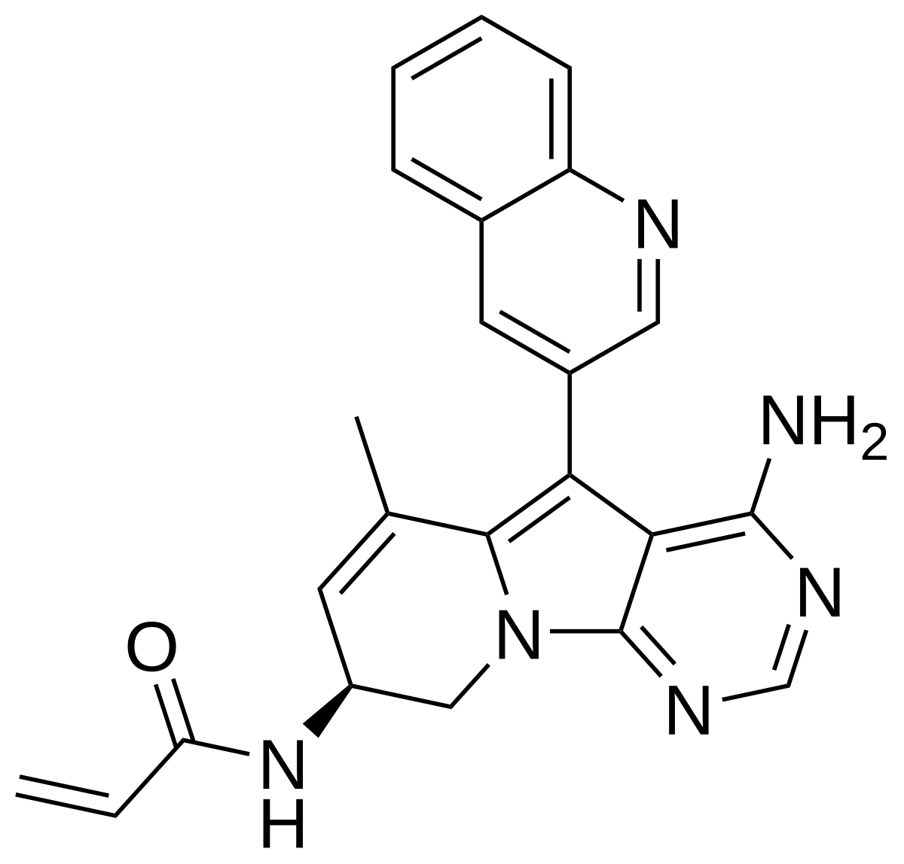
Zipalertinib
Small molecule EGFR tyrosine kinase inhibitor
Specificity for EGFR exon 20 insertions
Structure from Wikipedia!

Slide 50
Zipalertinib phase 1/2 trial in EGFR exon 20 ins
REZILIENT1 is a phase 1/2, open-label, multicenter trial (NCT04036682)
Primary endpoint:
ORR and DOR as assessed by blinded ICR per RECIST v1.1
Secondary endpoints:
ORR and DOR by investigator
DCR
CBR
PFS by ICR and investigator
OS
Antitumor activity in patients with CNS disease
Safety
Key eligibility criteria
Age ≥18 years
Locally advanced or metastatic NSCLC
Documented EGFR exon 20 insertion
ECOG PS 0 or 1
Stable/asymptomatic CNS metastases allowed
Prior platinum-based chemotherapy without prior ex20ins-targeted therapy
Zipalertinib
100 mg PO BID
Prior platinum-based chemotherapy with prior amivantamab ± other ex20ins-targeted therapy
Safety analysis population: all patients who received ≥1 dose of zipalertinib 100 mg BID (N=244)
Primary efficacy population: all patients who received ≥1 dose of zipalertinib 100 mg BID with ~8 months of minimum follow-up before data cutoff (December 10, 2024) (N=176)
Patients were assigned to a cohort based on previous therapy (ie, platinum-based chemotherapy only or amivantamab)
BID, twice daily; CBR, clinical benefit rate; CNS, central nervous system; DCR, disease control rate; DOR, duration of response; ECOG PS, Eastern Cooperative Oncology Group performance status; EGFR, epidermal growth factor receptor; ex20ins, exon 20 insertions; ICR, independent central review; NSCLC, non-small cell lung cancer; ORR, objective response rate; OS, overall survival; PFS, progression-free survival; PO, orally; RECIST, Response Evaluation Criteria in Solid Tumors.
Helena Alexandra Yu, MD
Yu et al, ASCO 2025
Notes:
Annotations
Bullet 1: JCO_REZILIENT1_MS text_Piotrowska_04Apr2025, p7 para2
Bullet 2/3: JCO_REZILIENT1_MS text_Piotrowska_04Apr2025, p7 para2 / p8 para5
Figure (eligibility): JCO_REZILIENT1_MS text_Piotrowska_04Apr2025, p7 para3 / p8 para1
Figure (treatment arms): JCO_REZILIENT1_MS text_Piotrowska_04Apr2025, p7 para1-3 / p8 para1 \ p11 para1
Figure (endpoints): JCO_REZILIENT1_MS text_Piotrowska_04Apr2025, p7 para4

Slide 51
Zipalertinib Best change from baseline in target lesions
120
100
Platinum-based chemotherapy without ex20ins-targeted therapy (n=125)
80
Platinum-based chemotherapy with amivantamab ± other ex20ins-target therapy (n=51)
60
40
20
0
Best change from baseline in target lesions (%)
–20
–40
–60
 | ORR, % (95% CI)
Prior platinum-based chemotherapy (n=125) | 40 (31–49)
Prior amivantamab without other ex20ins (n=30) | 30 (15–49)
Prior amivantamab and other ex20ins (n=21) | 14 (3–36)
Primary efficacy population (N=176) | 35 (28–43)
–80
–100
–120
Yu et al, ASCO 2025
Notes:
Annotations
Figure: FIG 1 waterfall plot
Table: JCO_REZILIENT1_MS text_Piotrowska_04Apr2025, p37 and p39 confirmed ORR rows

Slide 52
Zipalertinib Progression-free survival per ICR
100
Kaplan-Meier estimates of progression-free survival
 | Primary efficacy population (N=176) | Platinum-based chemotherapy without ex20ins-targeted therapy (n=125) | Prior amivantamab ± other ex20ins-target therapy (n=51)
Median PFS, months (95% CI) | 9.4 (7.4–10.0) | 9.5 (7.7–11.5) | 7.3 (5.3–9.7)
90
68.0%
63.8%
53.4%
80
70
60
50
32.0%
29.9%
24.8%
Progression-free survival (%)
40
30
24.7%
20
15.5%
10
0
0
3
6
9
12
15
18
21
24
27
30
33
36
39
42
45
48
51
54
No. at risk
Time from first dose (months)
Total
Platinum-based chemotherapy only
Prior amivantamab ± other ex20ins
176
125
51
144
103
41
95
71
24
57
42
15
22
15
7
15
10
5
7
7
0
6
6
0
6
6
0
6
6
0
6
6
0
4
4
0
4
4
0
3
3
0
3
3
0
3
3
0
3
3
0
1
1
0
0
0
0
Helena Alexandra Yu, MD
Yu et al, ASCO 2025
Notes:
Annotations
Figure: FIG 2 PFS and OS KMs
Footnote: JCO_REZILIENT1_MS text_Piotrowska_04Apr2025, p32

Slide 53
Zipalertinib Overall survival
6-month OS rate
100
85.8%
84.1%
79.9%
12-month OS rate
Primary efficacy population (N=176)
Platinum-based chemotherapy without ex20ins-targeted therapy (n=125)
Prior amivantamab ± other
ex20ins-target therapy (n=51)
90
73.4%
69.3%
59.8%
80
70
60
59.1%
Overall survival (%)
50
54.2%
40
30
20
10
0
0
3
6
9
12
15
18
21
24
27
30
33
36
39
42
45
48
51
54
Time from first dose (months)
No. at risk
Total
Platinum-based chemotherapy only
Prior amivantamab ± other ex20ins
176
125
51
158
113
15
137
99
38
88
64
24
51
38
13
32
23
9
21
17
4
14
14
0
13
13
0
12
12
0
12
12
0
10
10
0
10
10
0
9
9
0
7
7
0
5
5
0
5
5
0
3
3
0
0
0
0
Helena Alexandra Yu, MD
Yu et al, ASCO 2025
Notes:
Annotations
Figure: FIG 2 PFS and OS KMs
Footnote: JCO_REZILIENT1_MS text_Piotrowska_04Apr2025, p32

Slide 54
Zipalertinib Summary of adverse events
AE, No. (%) | Safety population (N=244)
TEAEs
Any TEAE | 242 (99.2)
Grade ≥3 TEAE | 137 (56.1)
TRAEs
Any TRAE | 223 (91.4)
Grade ≥3 TRAE | 72 (29.5)
TRAE leading to treatment modification
Dose reduction | 35 (14.3)
Dose interruption | 96 (39.3)
Treatment discontinuationª | 20 (8.2)
TRAE leading to death | 2 (0.8)
Median duration of treatment exposure was 6.4 months (range, 0.03–51.8)
Median relative dose intensity was 94.1%
TRAEs leading to treatment discontinuation was 8%
TRAEs that led to death were pneumonitis and hypoxia
Pneumonitis: 6 prior lines of treatment, including platinum-based chemotherapy, immunotherapy, amivantamab, mobocertinib, and medical history of thromboembolism and COVID-19
Hypoxia: 4 prior lines of treatment, including platinum-based chemotherapy, osimertinib, amivantamab, and lazertinib, and a medical history of thromboembolism and COVID-19
ªTRAEs leading to treatment discontinuation included pneumonitis (9 patients), and anemia, asthenia, erythema multiforme, fatigue, interstitial lung disease, myocarditis, neutrophil/platelet count decreased, paronychia, pneumonia, rash, and Stevens-Johnson syndrome (1 patient each).
AE, adverse event; TEAE, treatment-emergent adverse event; TRAE, treatment-related adverse event.
Helena Alexandra Yu, MD
Yu et al, ASCO 2025
Notes:
Annotations
Table: JCO_REZILIENT1_MS text_Piotrowska_04Apr2025, p40 table 4
Bullet 1/2: JCO_REZILIENT1_MS text_Piotrowska_04Apr2025, p12 para4
Bullet 3: JCO_REZILIENT1_MS text_Piotrowska_04Apr2025, p13 para2
Bullet 4: Added per comment from Shengting Li: “For the 2 death, would add a sentence that 1 pneumititis with 6 previous lines of Tx, including platinum-based chemo, immuno, ami, mobo and MHx of thromboembolism and covid. 1 hypoxia with 4 lines prior tx, platinum-based chemo, osi, ami and lazertinib and MHx thromboembolism and covid.”
Footnote A: JCO_REZILIENT1_MS text_Piotrowska_04Apr2025, p41 (but neutrophil count decreased and platelet count decreased combined per comment from Shengting Li – ‘’One pt had both ANC/Platelet decrease’’)

Slide 55
Zipalertinib Most common treatment-related adverse events
Any-grade TRAEs reported in ≥10% of patients, No. (%) | Any grade | Grade 3
Paronychia | 94 (38.5) | 0
Rash | 74 (30.3) | 6 (2.5)
Dermatitis acneiform | 60 (24.6) | 1 (0.4)
Dry skin | 60 (24.6) | 0
Diarrhea | 53 (21.7) | 5 (2.0)
Stomatitis | 49 (20.1) | 4 (1.6)
Anemia | 48 (19.7) | 17 (7.0)
Pruritus | 44 (18.0) | 1 (0.4)
Nausea | 35 (14.3) | 2 (0.8)
Rash maculopapular | 34 (13.9) | 3 (1.2)
Fatigue | 29 (11.9) | 0
Anemia was the most common grade 3 TRAE
Other grade ≥3 TRAEs reported in ≥5 patients included pneumonitis and rash (6 patients [2.5%] each), and alanine aminotransferase increased, diarrhea, and platelet count decreased (5 patients [2.0%] each)
Twelve patients (4.9%) had treatment-related pneumonitis, 5 of whom had received prior immunotherapy
Grade 1, n=3; grade 2, n=3; grade 3, n=5; grade 5, n=1
Helena Alexandra Yu, MD
Yu et al, ASCO 2025
Notes:
Annotations
Table: JCO_REZILIENT1_MS text_Piotrowska_04Apr2025, p41 table 4
Bullet 1: JCO_REZILIENT1_MS text_Piotrowska_04Apr2025, p12 para6
Bullet 2: JCO_REZILIENT1_MS text_Piotrowska_04Apr2025, p12 para5 / p13 para1
Bullet 3: JCO_REZILIENT1_MS text_Piotrowska_04Apr2025, p12 para5 (subbullet added by Shengting Li)
More detailed tox, please refer to concurrent manuscript

Slide 56
Conclusions
Demonstrated efficacy of zipalertinib in patients with EGFR ex20ins-mutant NSCLC who received prior platinum-based chemotherapy, including those who also received prior amivantamab
Zipalertinib has toxicity of what one would expect from an EGFR TKI
“Confirmatory phase 3 trial is ongoing” (Chemotherapy + zipalertinib vs chemotherapy in first line)
Accelerated approval is possible in the coming months
Yu et al, ASCO 2025
Notes:
Annotations
Bullet 1: Abstract Submission-ASCO 2025, p2A
Bullet 2: Abstract Submission-ASCO 2025, p2A; JCO_REZILIENT1_MS text_Piotrowska_04Apr2025, p15 para1
Bullet 3: Abstract Submission-ASCO 2025, p2A; JCO_REZILIENT1_MS text_Piotrowska_04Apr2025, p13 para3 / p14 para1 / p16 para2

Slide 57
First-line therapy for SCLC changed in 2018
Platinum/etoposide combination therapy was the standard for >20 years.
Incorporation of the immune checkpoint inhibitors atezolizumab and durvalumab into first-line therapy led to modest improvements in PFS and OS

Slide 58
Carboplatin/Etoposide +/- Atezolizumab: Progression-free survival
Horn et al, NEJM 2018.

Slide 59
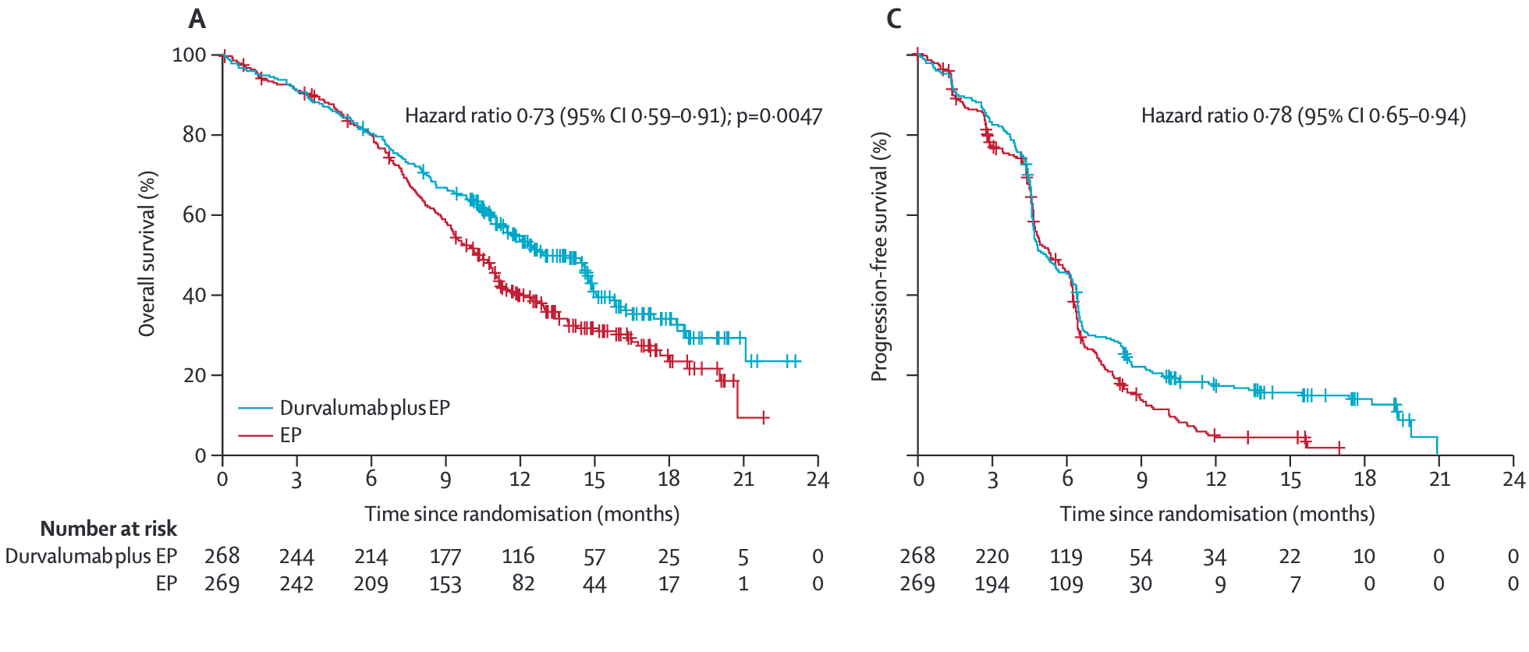
Platinum/etoposide +/- Durvalumab

Slide 60
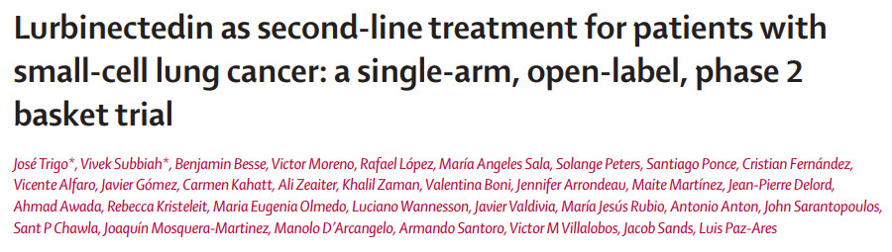
Natural product,
alkylating agent,
Common adverse events: fatigue, nausea, vomiting, constipation, diarrhea, anorexia, arthralgias, cytopenias
RR 35%
Translated into FDA accelerated approval
For patients with extensive stage small cell who have progressed, NCCN #1 preferred treatment is clinical trial enrollment!
Lancet Onc 2020

Slide 61
Paradigm of small cell prior to ASCO 2025?
Patients with extensive stage small cell lung cancer
Platinum
Etoposide
ICI
Maintenance ICI
until progression
Chemotherapy

Slide 62
There is an opportunity to consider in patients who have completed the chemotherapy and are just receiving continued ICI
Horn et al, NEJM 2018.

Slide 63
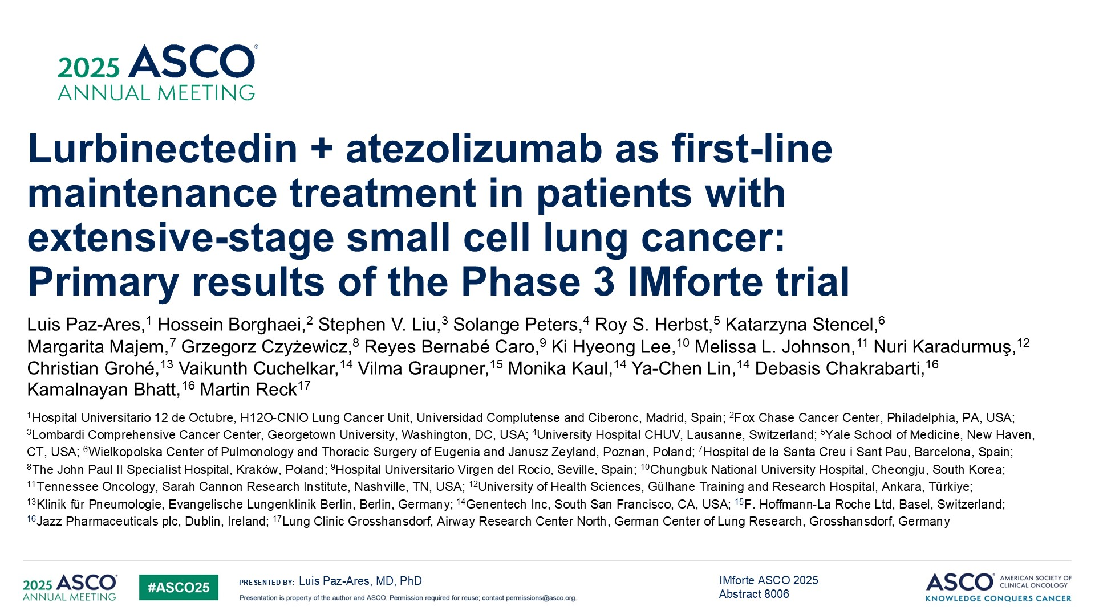
Lurbinectedin + atezolizumab as first-line maintenance treatment in patients with <br />extensive-stage small cell lung cancer: <br />Primary results of the Phase 3 IMforte trial

Slide 64
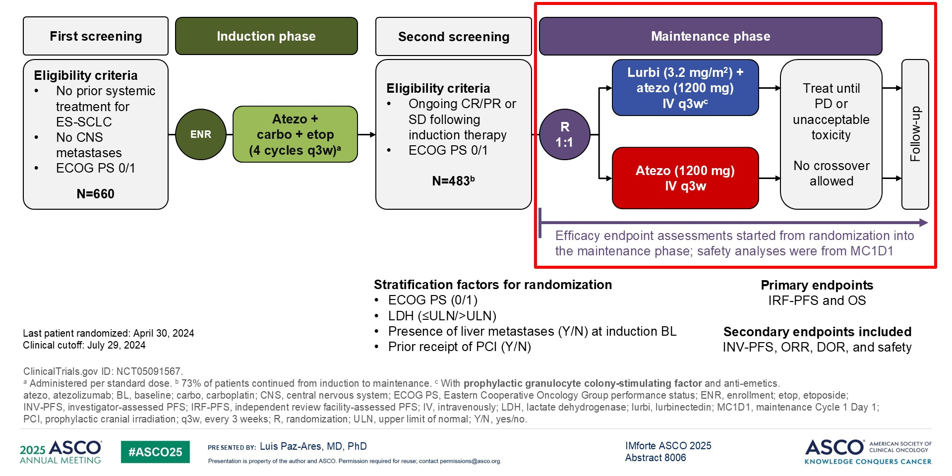
Maintenance Lurbinectidin + atezolizumab in small cell lung cancer
Paz-Ares ASCO 2025

Slide 65
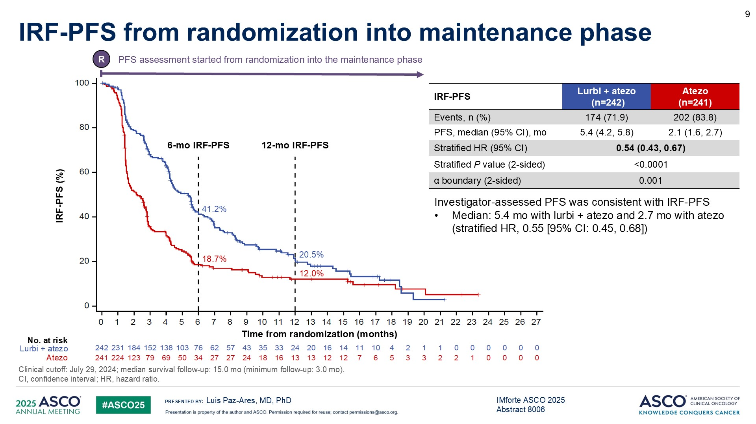
IRF-PFS from randomization into maintenance phase
Maintenance Lurbinectidin + atezolizumab in small cell lung cancer
Paz-Ares ASCO 2025

Slide 66
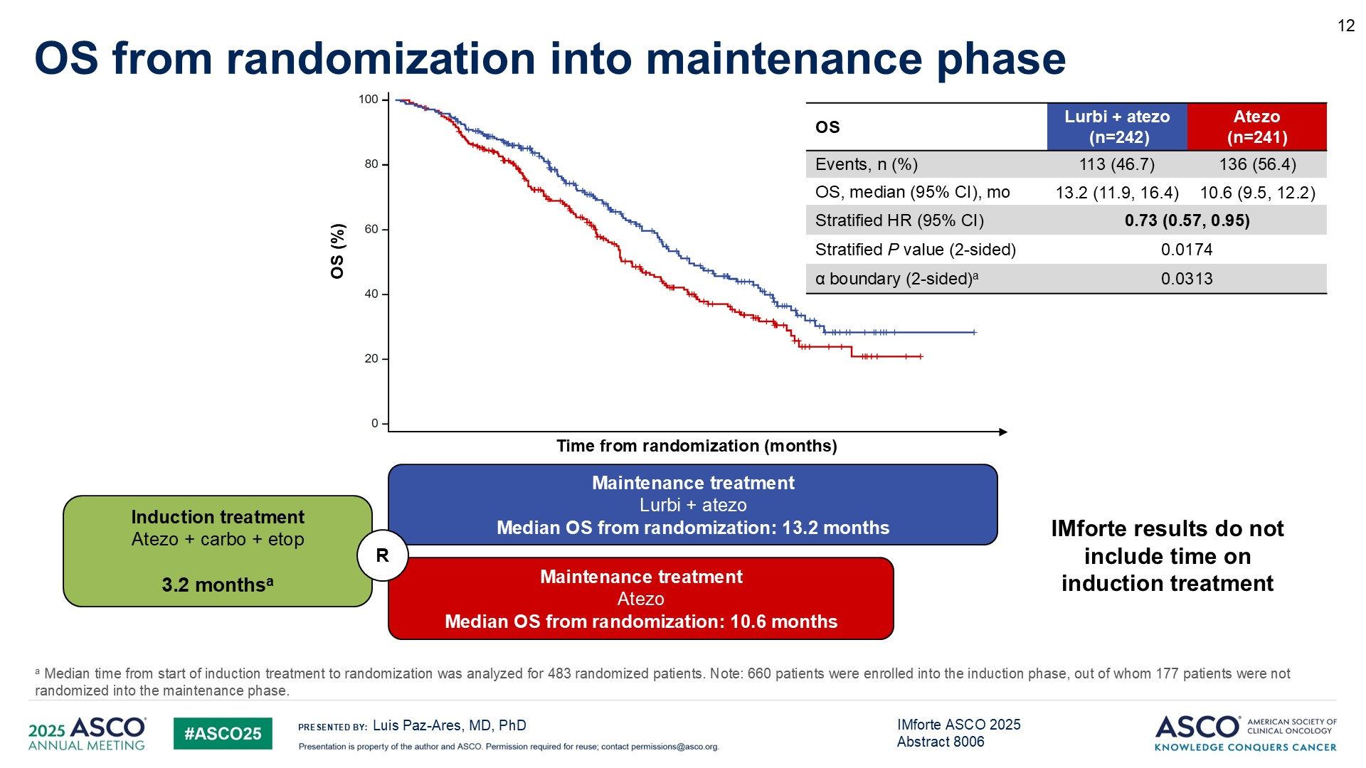
OS from randomization into maintenance phase
Maintenance Lurbinectidin + atezolizumab in small cell lung cancer
Paz-Ares ASCO 2025

Slide 67
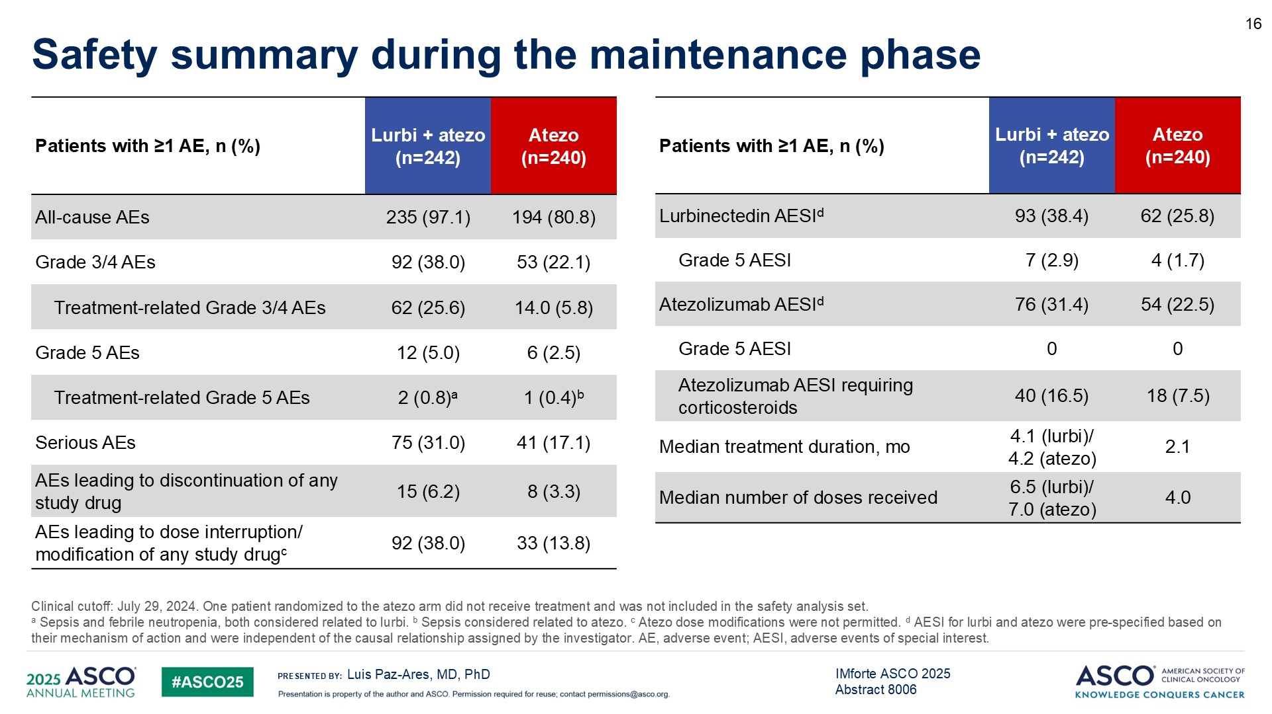
Safety summary during the maintenance phase
Maintenance Lurbinectidin + atezolizumab in small cell lung cancer
Paz-Ares ASCO 2025

Slide 68
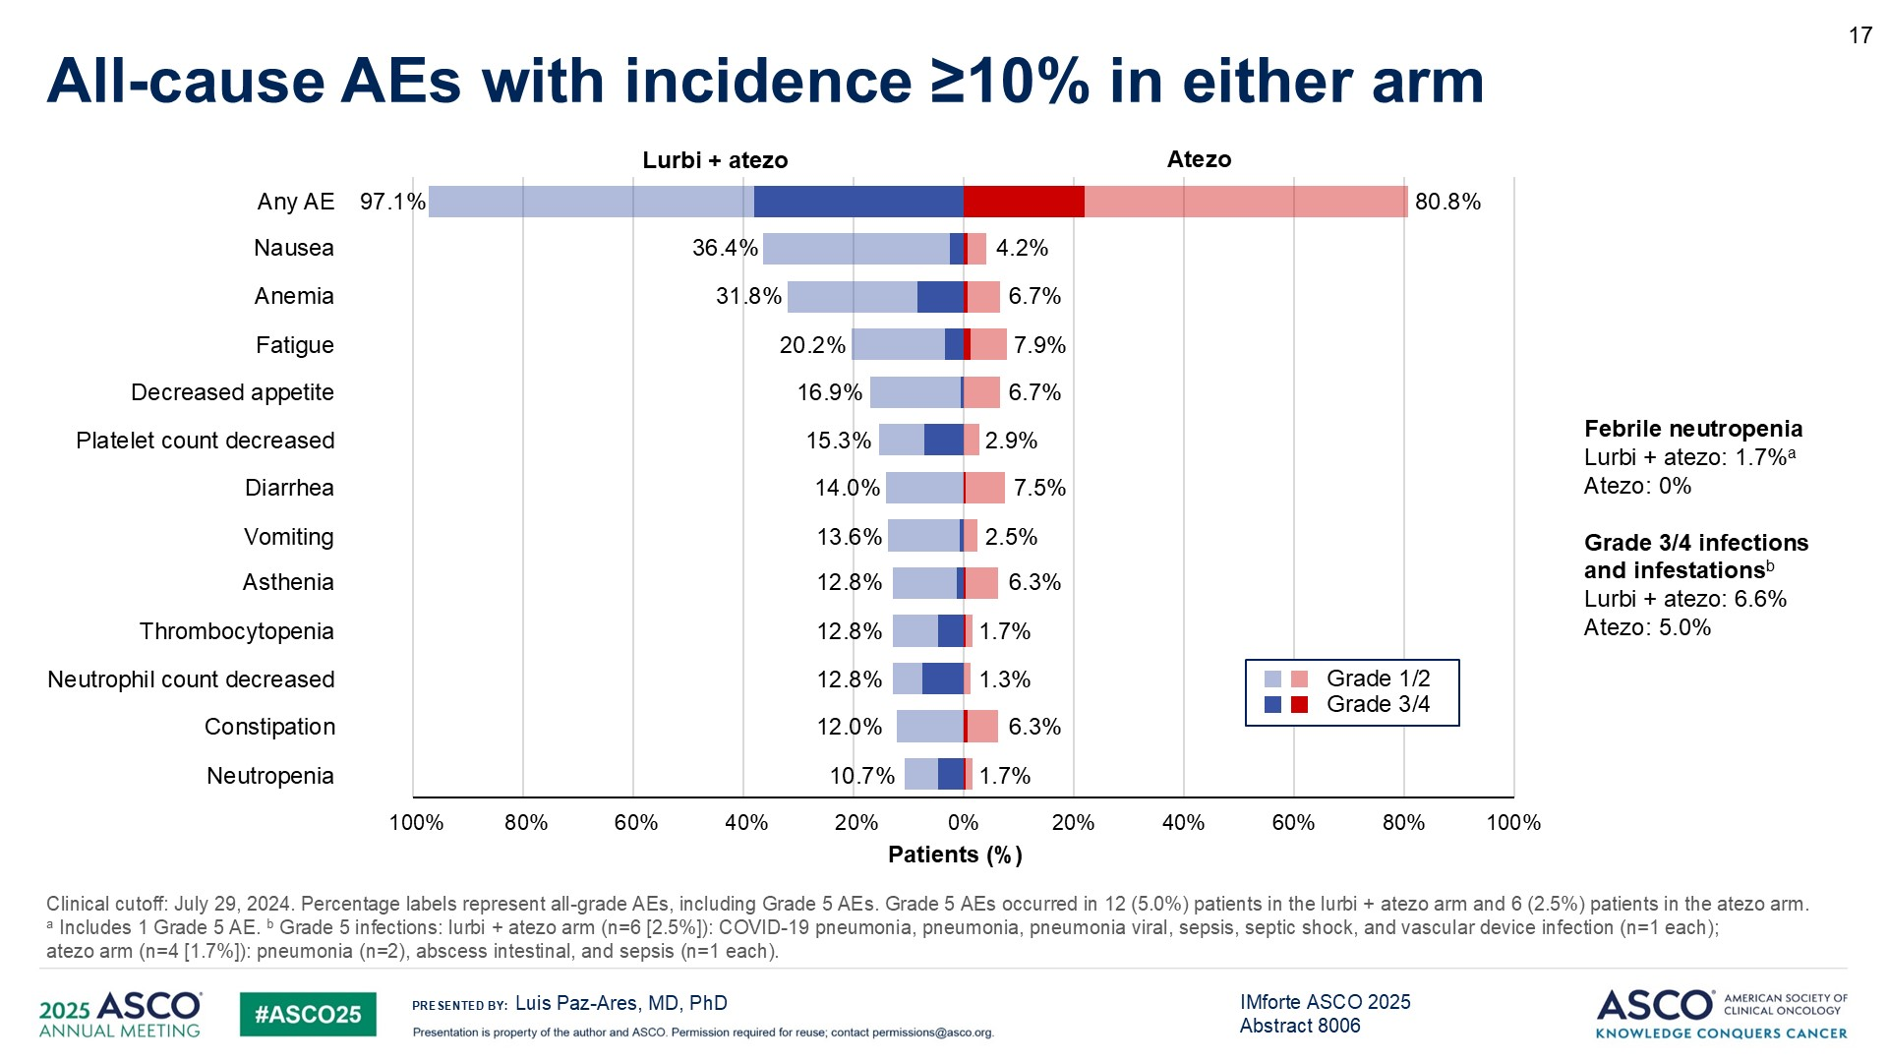
All-cause AEs with incidence ≥10% in either arm
Maintenance Lurbinectidin + atezolizumab in small cell lung cancer
Paz-Ares ASCO 2025

Slide 69
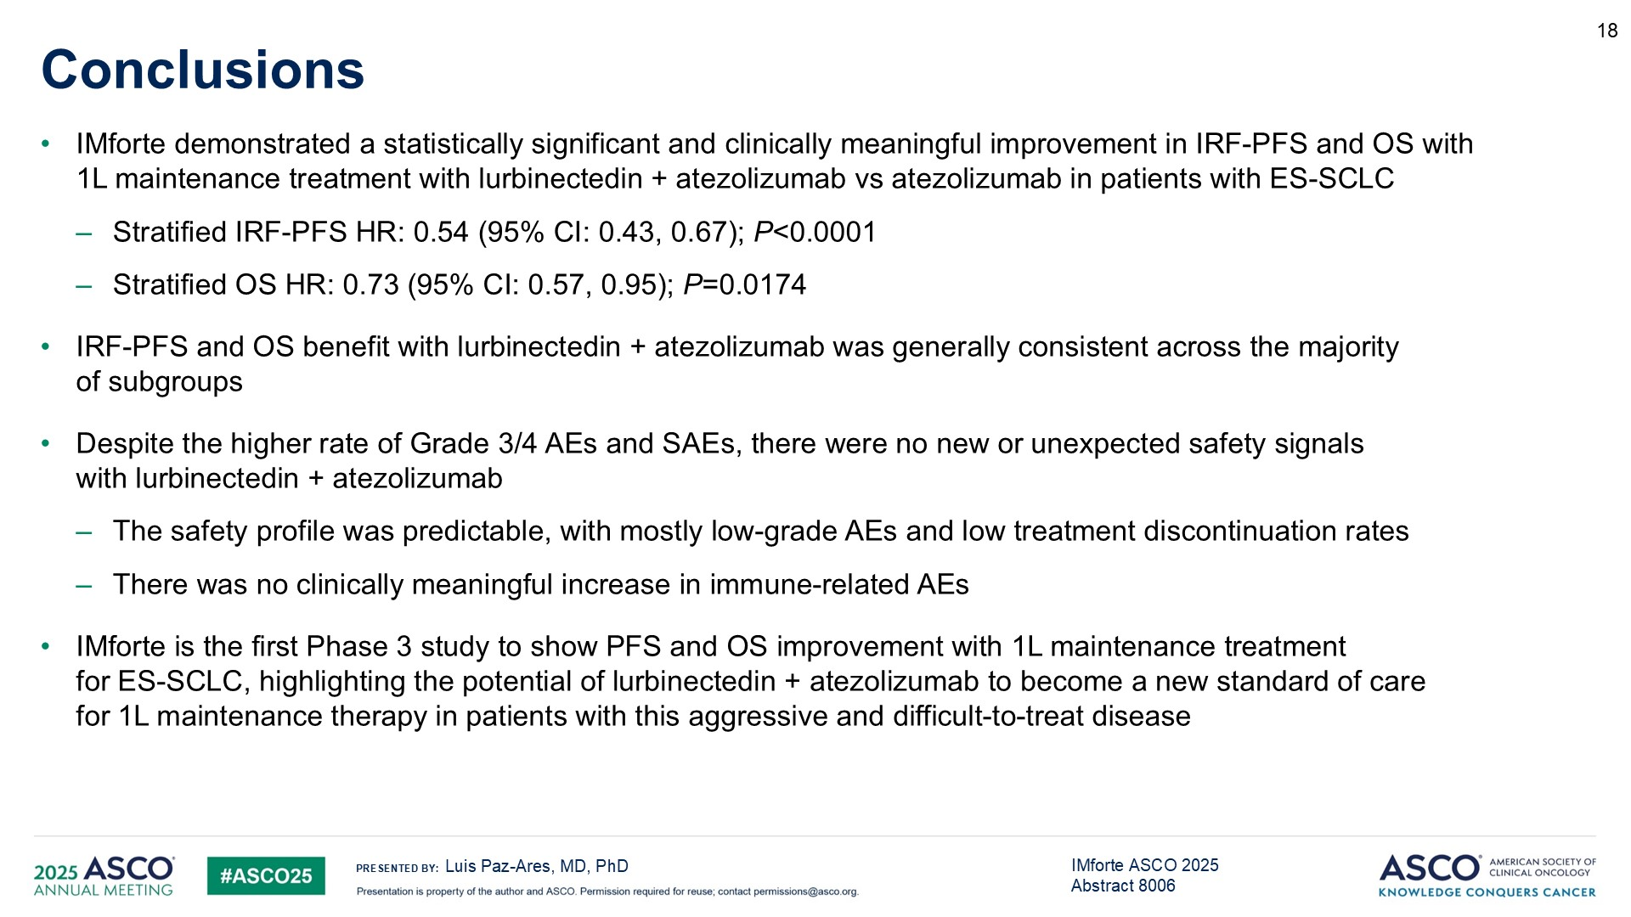
Conclusions
Paz-Ares ASCO 2025

Slide 70
Tarlatamab versus chemotherapy as second-line treatment for small cell lung cancer (SCLC):
primary analysis of the phase 3 DeLLphi-304 study
Charles M. Rudin, Giannis S. Mountzios, Longhua Sun, Byoung Chul Cho, Umut Demirci, Sofia Baka, Mahmut Gumus, Antonio Lugini, Tudor-Eliade Ciuleanu, Myung-Ju Ahn, Pedro Rocha, Bo Zhu, Fiona Blackhall, Tatsuya Yoshida, Taofeek K. Owonikoko, Luis Paz-Ares, Shuang Huang, Diana Gauto, Gonzalo Recondo, Martin Schuler
Speaker: Charles M. Rudin, MD, PhD, Fiona and Stanley Druckenmiller Center for Lung Cancer Research, Memorial Sloan Kettering Cancer Center, New York, USA.

Slide 71
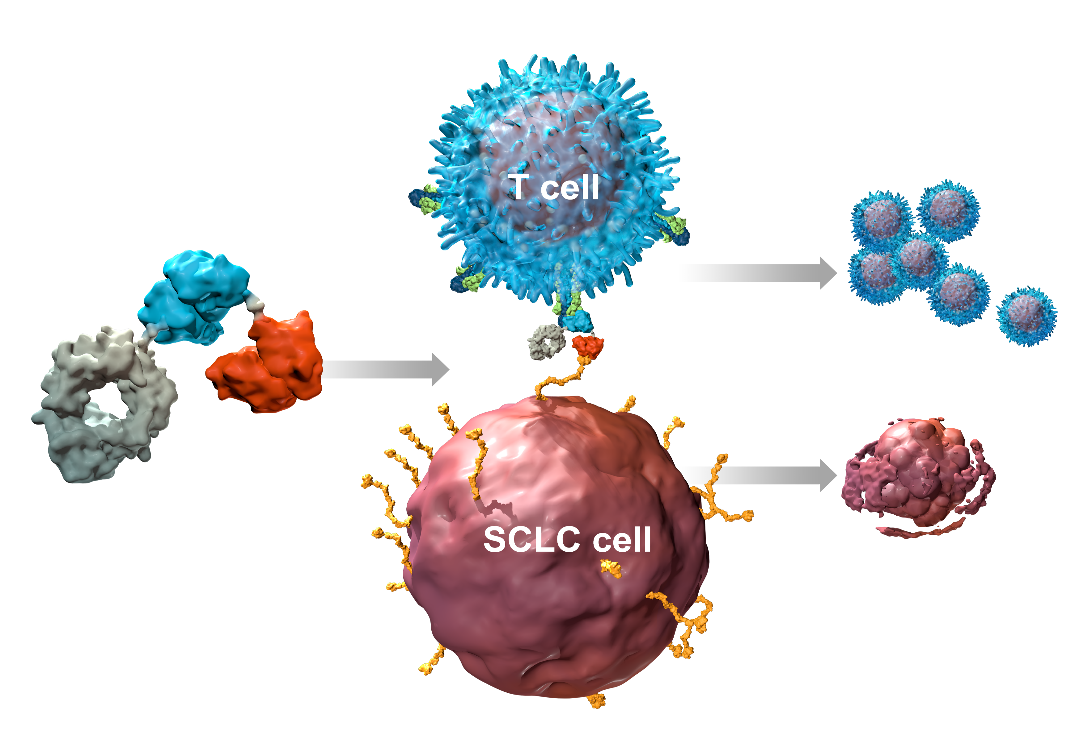
Tarlatamab
Tarlatamab is a bispecific antibody that binds to CD3 (on T-cells) and DLL3
DLL3 is expressed in >90% of small cell lung cancers
Tarlatamab had accelerated approval based on single-arm trial showing efficacy
Tarlatamab
CD3 Binding
Domain
T-Cell
Expansion
CD3
DLL3
DLL3 Binding
Domain
Cancer Cell
Apoptosis
Effectorless Fc Domain
Rudin ASCO 2025

Slide 72
Tarlatamab phase 3 trial
Key inclusion criteria Histologically or cytologically confirmed SCLC Progression after 1L platinum-based chemotherapy +/- anti-PD-(L)1 ECOG PS 0 or 1 Asymptomatic, treated or untreated brain metastases Randomization stratified by Prior anti-PD-(L)1 exposure (yes/no) Chemotherapy-free interval (< 90 days vs ≥ 90 to < 180 days vs ≥ 180 days) Presence of (previous/current) brain metastases (yes/no) Intended chemotherapy (topotecan/amrubicin vs lurbinectedin)
Tarlatamab (n = 254)
R
1:1
(N = 509)
Chemotherapy* (n = 255)
Topotecan (n = 185); Lurbinectedin (n = 47); Amrubicin (n = 23)
 | Primary Endpoint: Overall survival Key Secondary Endpoints: Progression-free survival, patient-reported outcomes Other Secondary Endpoints: Objective response, disease control, duration of response, safety
*Topotecan was used in all countries except Japan, lurbinectedin in Australia, Canada, Republic of Korea, Singapore and the United States, and amrubicin in Japan.
1L, first-line; ECOG PS, Eastern Cooperative Oncology Group performance status; PD-(L)1, programmed death (ligand)-1; R, randomization; SCLC, small cell lung cancer.
Rudin et al, ASCO 2025

Slide 73
Tarlatamab phase 3 overall survival
 | Tarlatamab (n = 254) | Chemotherapy (n = 255)
Median OS, months | 13.6 | 8.3
HR (Tarlatamab/Chemotherapy) (95% CI) | 0.60 (0.47, 0.77)
p-value (2-sided) | p < 0.001
100
Tarlatamab
Chemotherapy
80
|
76%
|
|
|
|
|
|
|
|
|
|
|
|
|
|
|
|
|
|
|
|
|
|
|
|
|
|
|
|
|
|
|
|
|
|
|
|
|
|
|
|
|
|
|
|
|
|
|
|
|
|
|
|
|
|
|
|
|
|
|
|
|
|
|
|
|
|
60
|
|
|
|
53%
|
|
|
|
|
|
|
|
|
|
|
|
|
|
|
62%
|
|
|
|
Overall Survival (%)
|
|
|
|
|
|
|
|
|
|
|
|
|
|
|
|
|
|
|
|
|
|
|
|
|
|
|
|
|
|
|
|
|
|
|
|
|
|
|
|
|
|
|
|
|
|
|
|
|
|
|
|
|
|
|
|
|
|
|
|
|
|
|
|
|
|
|
|
|
|
|
|
|
|
|
|
|
|
|
|
|
|
|
|
|
|
|
|
|
|
|
|
|
|
|
|
|
40
|
|
|
|
|
|
|
|
|
|
|
|
|
|
|
|
|
|
|
|
|
|
|
|
|
|
|
|
|
|
|
|
|
|
|
|
|
|
|
|
|
|
|
|
|
|
37%
|
|
|
|
|
|
|
|
|
20
|
|
|
|
0
0
3
6
9
12
15
18
21
Time from randomization (months)
Number of patients at risk:
Tarlatamab
254
220
192
131
60
17
0
Chemotherapy
255
210
156
97
42
9
2
0
Median follow-up time: 11.2 months for the tarlatamab group and 11.7 months for the chemotherapy group. p-value was calculated using a stratified log-rank test. HR, hazard ratio; OS, overall survival.
Rudin et al, ASCO 2025

Slide 74

Tarlatamab phase 3 Progression-free survival
100
 | Tarlatamab (n = 254) | Chemotherapy (n = 255)
Median PFS, months | 4.2 | 3.7
HR (Tarlatamab/Chemotherapy) (95% CI) | 0.71 (0.59, 0.86)
RMST p-value (2-sided) | p = 0.002*
|
|
|
|
|
|
80
60
|
|
|
Progression-free Survival, %
40
31%
|
|
|
|
|
|
|
|
|
|
20%
|
|
|
|
|
|
|
|
|
|
|
|
|
|
|
|
|
|
|
|
|
|
|
|
|
|
20
|
|
|
|
23%
|
|
|
|
|
|
|
|
|
|
|
|
|
|
|
|
|
|
|
|
|
|
|
|
|
|
|
|
|
|
|
|
|
|
|
0
4%
|
0
3
6
9
12
15
18
Number of patients at risk:
Time from randomization (months)
Tarlatamab
254
147
78
37
18
2
0
Chemotherapy
255
137
56
15
3
0
Median follow-up time: 11.0 months for the tarlatamab and the chemotherapy group. *The restricted mean PFS time in the tarlatamab and the chemotherapy group was 5.3 months and 4.3 months at 12 months respectively, resulting in statistically significant improvement of the tarlatamab group over the chemotherapy group.
HR: hazard ratio; PFS, progression-free survival.
Rudin et al, ASCO 2025

Slide 75
Tarlatamab was associated with more frequent and more durable responses
 | Tarlatamab (n = 254) | Chemotherapy (n = 255)
Best overall response*†, n (%)
Complete response | 3 (1) | 0 (0)
Partial response | 86 (34) | 52 (20)
Stable disease | 84 (33) | 112 (44)
Progressive disease | 56 (22) | 50 (20)
Not evaluable/no post-baseline scan | 25 (10) | 41 (16)
Objective response rate‡, % (95% CI) | 35 (29–41) | 20 (16–26)
Median duration of response, months | 6.9 | 5.5
Median time to objective response, months | 1.5 | 1.4
Ongoing response at data cutoff, n§ (%) | 42 (47) | 8 (15)
Duration of response
Tarlatamab
Chemotherapy
100
|
|
 | Tarlatamab (n = 254) | Chemotherapy (n = 255)
Median DOR, months | 6.9 | 5.5
|
80
|
|
|
|
60
|
|
|
56%
|
|
|
|
|
|
|
|
|
Responders Without Progression or Death (%)
|
|
|
|
|
|
|
|
|
41%
|
40
|
|
|
|
|
|
|
|
|
|
|
|
|
|
|
|
29%
20
|
|
|
|
13%
|
|
|
0
0
3
6
9
12
15
18
Time from initial response (months)
Number of patients at risk:
Tarlatamab
89
70
41
22
12
2
0
Chemotherapy
52
40
14
2
1
0
*Assessment of disease response was based on RECIST 1.1 guidelines. Confirmation of complete response and partial response was required no fewer than 4 weeks after initial documentation of complete response or partial response. †Investigator-assessed response in the intention-to-treat analysis set; ‡Odds ratios and p value not shown as the difference in ORR between the 2 arms was not formally tested. §Percentage of total number of responders.
DOR, duration of response; IRECIST, Response Evaluation Criteria in Solid Tumors.
Rudin et al, ASCO 2025

Slide 76
Tarlatamab had a more favorable safety profile
 | Tarlatamab (n = 252)* | Chemotherapy (n = 244)*
Median duration of treatment, months, (range) | 4.2 (< 1–17) | 2.5 (< 1–15)
All grade, TEAEs, n (%) | 249 (99) | 243 (100)
All grade, TRAEs n (%) | 235 (93) | 223 (91)
Grade ≥ 3 TRAEs, n (%) | 67 (27) | 152 (62)
Serious TRAEs, n (%) | 70 (28) | 75 (31)
TRAEs leading to dose interruption and/or dose reduction, n (%) | 48 (19) | 134 (55)
TRAEs leading to discontinuation, n (%) | 7 (3) | 15 (6)
Treatment-related grade 5 events†, n (%) | 1 (0.4) | 4 (2)
*Safety analysis set (all patients who received at least one dose of study treatment). †The single grade 5 TRAE observed with tarlatamab was attributed to ICANS in the setting of progressive neurological decline concurrent with persistent fever, hypoxemia, and hypotension. Grade 5 TRAEs observed with chemotherapy were attributed to general physical health deterioration (n = 1), pneumonia (n = 1), respiratory tract infection (n = 1), and tumor lysis syndrome (n = 1).
ICANS, immune effector cell-associated neurotoxicity syndrome; TEAE, treatment-emergent adverse event; TRAE, treatment-related adverse event.
Rudin et al, ASCO 2025

Slide 77
CRS and ICANS events were consistent with tarlatamab’s established safety profile
Treatment-emergent CRS and ICANS with tarlatamab
CRS with first two infusions
Tarlatamab (N = 252) | Minimum required monitoring duration
 | 6 - 8 Hours (n = 43) | 48 Hours (n = 209)
Treatment emergent CRS, n (%)* | 16 (37) | 125 (60)
Grade 1 | 12 (28) | 94 (45)
Grade 2 | 4 (9) | 28 (13)
Grade 3 | 0 (0) | 3 (1)
Serious adverse events | 3 (7) | 39 (19)
Leading to discontinuation of IP | 0 (0) | 1 (0.5)
Median time to intervention from last tarlatamab dose (hours) | 17 | 27
*Grade 4 CRS or ICANS events were not observed. A single grade 5 treatment-related adverse event observed with tarlatamab was attributed to ICANS in the setting of progressive neurological decline concurrent with persistent fever, hypoxemia, and hypotension. CRS, cytokine release syndrome; ICANS, immune effector cell-associated neurotoxicity syndrome; IP, investigational product.
Rudin et al, ASCO 2025

Slide 78
Patients treated with tarlatamab experienced lower incidence
of high-grade AEs
Treatment-emergent Adverse Events in > 10% of Patients
Grade ≥ 3 Treatment-emergent Adverse Events in > 5% of Patients
More Frequent
with Chemotherapy
More Frequent
with Tarlatamab
More Frequent
with Chemotherapy
More Frequent
with Tarlatamab
Cytokine release syndrome
Dysgeusia
Hyponatremia
Pyrexia
Decreased appetite
Pneumonia
Hyponatremia
Headache
Constipation
Fatigue
Weight decreased
Vomiting
Neutrophil count decreased
Dizziness
Cough
Fatigue
Platelet count decreased
White blood cell count decreased
Asthenia
Febrile neutropenia
Pneumonia
Diarrhea
Dyspnea
Thrombocytopenia
Nausea
Neutrophil count decreased
Leukopenia
Febrile neutropenia
Leukopenia
Neutropenia
Platelet count decreased
Thrombocytopenia
Neutropenia
Anemia
Anemia
–25
0
25
50
–20
0
20
Risk Difference (%)
Risk Difference (%)
*Adverse events (AEs) shown include adverse events of interest for tarlatamab and selected known adverse events for chemotherapy.
Rudin et al, ASCO 2025

Slide 79
Tarlatamab conclusions
Compared to standard of care chemotherapy (mostly topotecan), tarlatamab had improved efficacy
Overall Survival HR 0.6, p<0.001
Progression free survival HR 0.71, p=0.002
Responses were more durable
Tarlatamab has a unique side effect profile
CRS and ICANS were mostly grade 1 or 2 in severity

Slide 80
ASCO 2025 – lung cancer
NSCLC
chemo+IO as neoadjuvant therapy remains the standard of care. It remains unclear what additional value post-operative immunotherapy brings when IO is incorporated into pre-op therapy.
Alectinib and Osimertinib can be considered for patients with resectable NSCLC with ALK and EGFR respectively
Zipalertinib shows efficacy in patients with EGFR exon 20 insertion NSCLC
Small Cell
Randomized phase 3 trial shows clear benefit of tarlatamab compared with chemotherapy (OS and PFS)
Maintenance lurbinectedin + atezolizumab leads to improvement in OS with some additional toxicity

